Slide 1
Inclusive excellence Updates
Presentation to the Provost Council
April 6th , 2021

Slide 2
Presentation Overview
Diversity and Affirmative Action Reports
Inclusive Hiring Practices
Inclusive Excellence Statement and Prompts
We Soar: Building a Culture of Inclusive Excellence
Inclusive Excellence Champions
M

Slide 3
Affirmative Action
Rose Costello
Associate Vice President of Human Resources

Slide 4
What is Affirmative Action?
This is a federal mandate to annually review and implement programs that are designed to ensure the number of qualified women, minorities, and individuals with disabilities are reflected in our total workforce and employment applicant pools.
There is clear guidance on how we determine the availability of women and minorities by job group, factoring in our internal workforce and external labor pool.
Federal law requires that goals be established if the number of women and minorities fall short of availability for each job group.
R

Slide 5
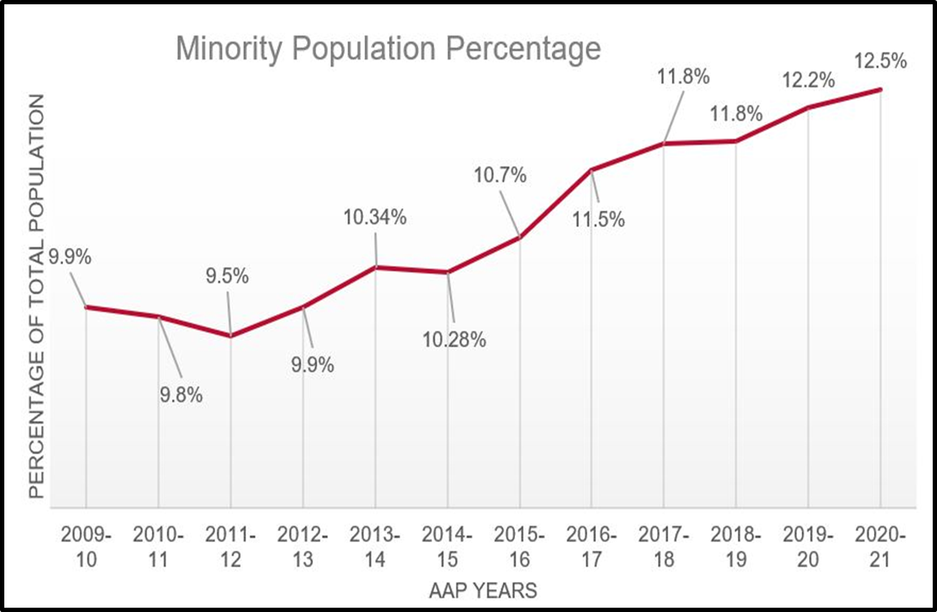
Total Workforce: Minority Population
R

Slide 6
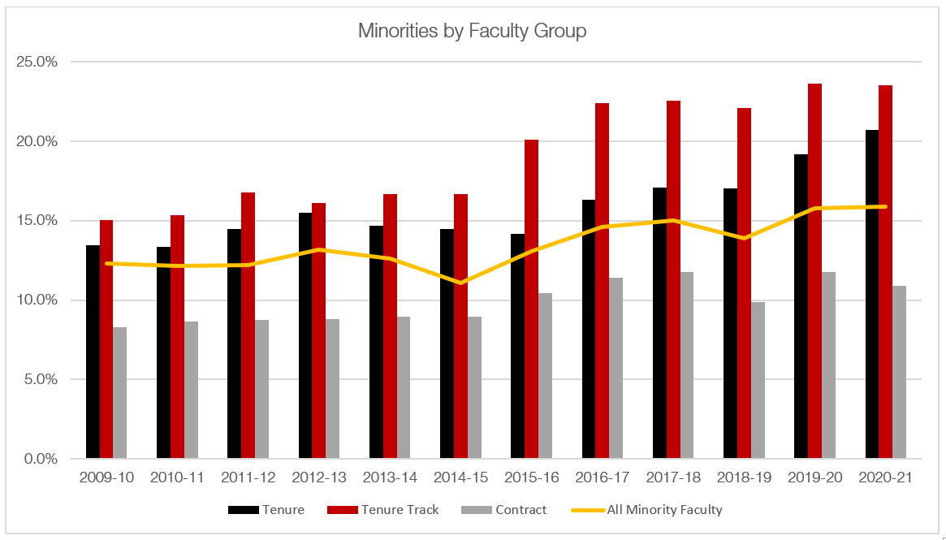
Minorities by Faculty Group
R

Slide 7
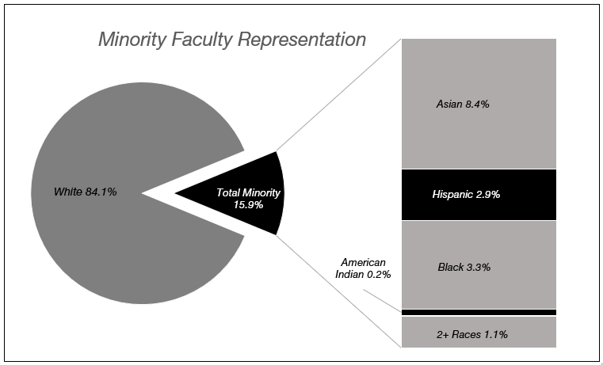
Minorities by Faculty Group
R

Slide 8
Workforce Breakdown: Job Group Analysis
Our total workforce is divided into 75 job groups, each made up of jobs that are similar in duties, responsibilities, opportunity and wages.
In 60 job groups, our workforce matches the relevant labor pool of qualified women and minorities, and therefore federal law does not require placement goals for these job groups.
We have identified 15 job groups where women and minorities are underutilized. Action-oriented initiatives are in place to meet these federal placement goals.
R

Slide 9
Action-Oriented Programs: Recruitment, Training & Infrastructure of Support
HR and OIE will continue to deliver search committee training to create awareness of unintended implicit bias in the selection process.
The University will continue cross university collaboration, system improvements and enhanced resources to guide hiring supervisors continue.
R

Slide 10
2020-21 annual diversity report
Dr. Marsha McGriff
Associate Vice President for Inclusive Excellence

Slide 11
Annual Diversity Report Components
The Board of Trustees shall create a diversity committee to do the following:
Task 1: Review and recommend faculty employment policies concerning diversity issues.
Task 2 : Review faculty and administration personnel complaints concerning diversity issues.
Task 3: Make recommendations to promote and maintain cultural diversity among faculty members.
Task 4: Make recommendations to promote recruitment and retention of underrepresented minority (URM) students.
M

Slide 12
Recommendation Highlights
The Provost, HR, and OIE will provide education and support with academic deans and unit heads about affirmative action goals and inclusive hiring strategies. (IE Plan 1.3.1.)
Education and/or training of faculty, staff and students about the University’s policies and procedures, including those for complaints as well as education about the University’s retaliation prohibition for filing or participating in a complaint. (IE Plan 6.3.1.)
Monitor campus climate for current issues as well as comparison of yearly data to better understand the campus climate regarding diversity and inclusion. (IE Plan 5.1.1.)
M

Slide 13
Recommendation Highlights – continued.
Implement a Culture Assessment Strategy in 2021-22 and culminate with a Culture Survey. (IE Plan 5.1.1.)
Continue faculty and staff mentoring programs and create new mentoring initiatives/priorities based upon feedback and assessment from participants. (IE Plan 2.3.1.)
Seek broad participation of diverse populations in undergraduate and graduate research, experiential, and immersive learning opportunities. (IE Plan 2.1.2. & 2.1.2.)
M

Slide 14
Inclusive Hiring Practices

Slide 15
Inclusive Excellence Applicant Statements
IE Applicant Statements: Effective immediately for Academic Affairs, all applicants for faculty and professional staff positions, will be required to submit a personal statement on how they will contribute to the development of a diverse and inclusive learning community at Ball State.
Tools and resources:
  Rubric for search committees to use to evaluated the applicants’ statements
  Training will be included for search committees
  Cultural competencies and Behavior Based descriptors: to potentially add to job descriptions, create behavior-based interview questions and performance evaluations.
R

Slide 16
Applicant’s Inclusive Excellence Prompt
Faculty version:
"At Ball State University, Inclusiveness is one of our enduring values and informs all of our efforts. We encourage applicants to familiarize themselves with our Inclusive Excellence Plan to learn more about our commitment and to identify how you might contribute to these efforts.
Inclusive Excellence Plan | Ball State University (bsu.edu)
In your application, please describe how you would contribute to the development of a diverse and inclusive learning community at Ball State University through your teaching, research, and/or service."
R

Slide 17
Applicant’s Inclusive Excellence Prompt
Professional version:
"At Ball State University, Inclusiveness is one of our enduring values and informs all of our efforts. We encourage applicants to familiarize themselves with our Inclusive Excellence Plan to learn more about our commitment and to identify how you might contribute to these efforts.
Inclusive Excellence Plan | Ball State University (bsu.edu)
In your application, please describe how you would contribute to the development of a diverse and inclusive learning community at Ball State University in this position."
R

Slide 18
Applicant’s Inclusive Excellence Prompt
Staff and Service version:
"At Ball State University, Inclusiveness is one of our enduring values and informs all of our efforts. We encourage applicants to familiarize themselves with our Inclusive Excellence Plan to learn more about our commitment and to identify how you might contribute to these efforts.”
Inclusive Excellence Plan | Ball State University (bsu.edu)
R

Slide 19
Inclusive Excellence Statement for All Job Postings
At Ball State we strive to be an open and inclusive campus and community that welcomes and embraces people of various backgrounds and ideals. We recognize that our strength is in the diversity of our students, faculty, and staff and we strive to value the intrinsic worth of all of our community members. Ball State recognizes diversity in all its forms including but not limited to; race, ethnicity, socio-economic status, sexual orientation, gender identity or expression, disability/ability, veteran status, or age.
Ball State University is committed to free and open inquiry, and our University offers all members of the University community—including students, faculty, staff, and visitors—the broadest possible latitude to speak, write, listen, challenge, and learn.
DRAFT 04/05/2021
M

Slide 20
Inclusive Hiring Strategies, Principles, and Checklist Guide
Contains five key resources for building a search process that reaches the most qualified candidates, and in the process creates a more diverse applicant pool. It includes:
The Broader Context
Steps for the Search Process
The Inclusion Continuum
Sample Unit Diversity Plan for Recruitment
Inclusive Excellence Statement Requirement with Evaluation Rubric & Timing of Faculty Searches
Checklist for Search Committee Chairs for Inclusive Searches
M

Slide 21
Inclusive Hiring Outreach and Support
Affirmative Action Briefings & Inclusive Excellence Plan Support
  We will be meeting with Deans in the coming weeks to talk about affirmative action goals, inclusive excellence plan updates, and data and trends.
Recruitment Strategy:
  All hiring supervisors will include a recruitment strategy to yield qualified women and minorities in their applicant pools in TMS.
Diversity of Applicant Pool Assessed Prior to Close of Posting:
  Hiring supervisors will be informed of Affirmative Action goals for the search and the diversity of the applicant pool will be assessed to determine if additional outreach efforts are needed.
R

Slide 22
Initiatives

Slide 23
Initiatives
We Soar: Building a Culture of Inclusive Excellence: At Ball State University, we acknowledge inclusive excellence as one of our enduring values and a fundamental part of accomplishing our 2040 Strategic Plan. We want to create a supportive and diverse community and culture at Ball State, recognizing each community member's intrinsic values.
Inclusive Excellence Champions: program that will training faculty and staff on the IE Plan, the Toolkit, Microaggressions, Implicit Bias,, How to be an ally to diverse racial and ethnic minorities, LGBTQ+ Individuals, people from diverse religious backgrounds and people with diverse disabilities. They will also receive search committee training and inclusive hiring practices.
M
Notes:
At Ball State University, we acknowledge inclusive excellence as one of our enduring values and a fundamental part of accomplishing our 2040 Strategic Plan. We want to create a supportive and diverse community and culture at Ball State, recognizing each community member's intrinsic values.
This Includes:
Day of Dialogue Kickoff
The Ball State Culture and Values Website
A new bias incident reporting system
Small Group Dialogues – with Andra’ Ward
Ongoing assessments of services for faculty, staff, and students
Campus-wide online culture and climate survey in Spring 2022
Inclusive Excellence Roundtable
Other various programs throughout the year
Inclusive Excellence Champions is a program that will training faculty and staff on the IE Plan, the Toolkit, Microagressions, Implicit Bias,, How to be an ally to diverse racial and ethnic minorities, LGBTQ+ Individuals, people from diverse religious backgrounds and people with diverse disabilities. They will also receive search committee training and inclusive hiring practices.

