Slide 1


LABORATORY WASTE MANAGEMENT AND WASTE CHARACTERISTICS
Presented by the:
Environmental Health
and Safety Office
August 2023

Slide 2
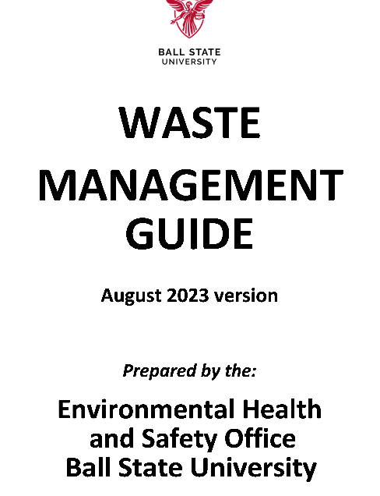
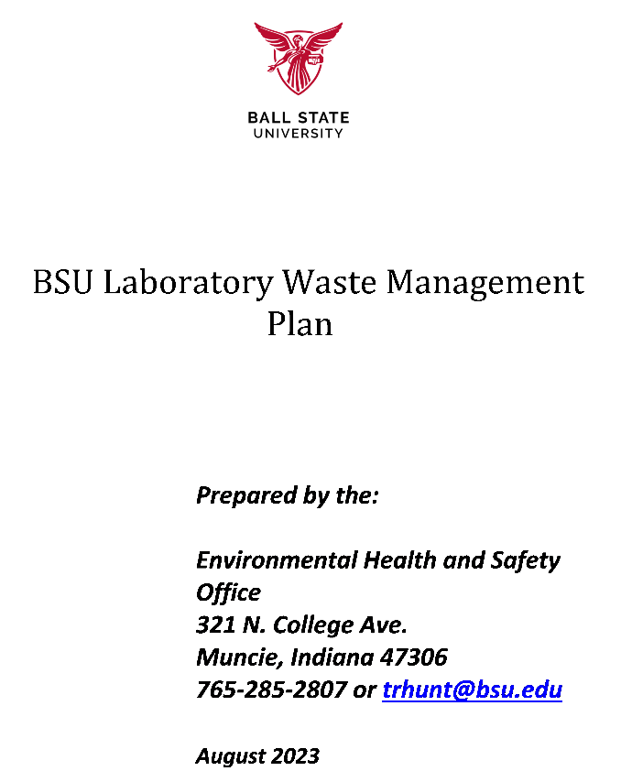
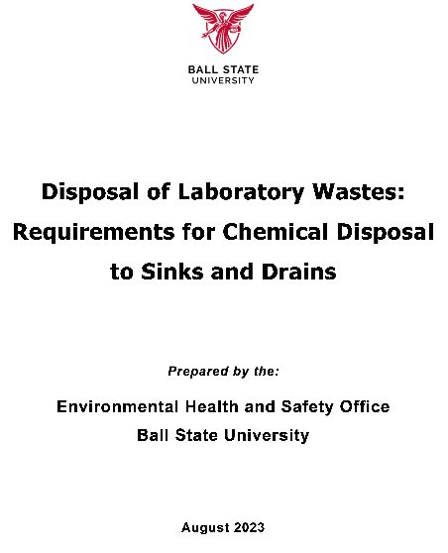
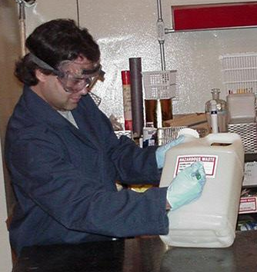
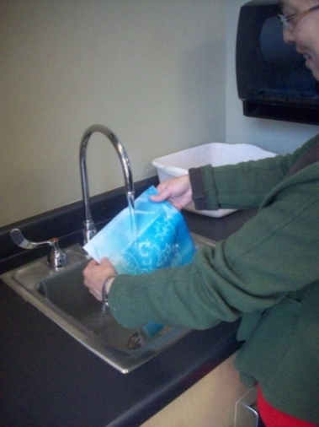
Laboratory Waste References

Slide 3

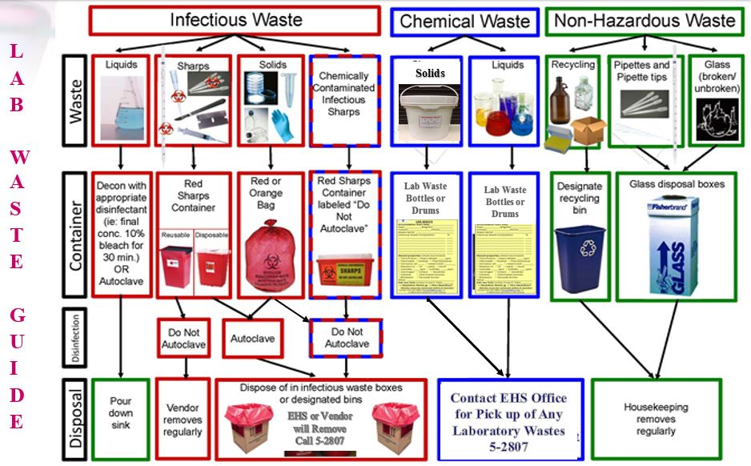
LABORATORY WASTES

Slide 4
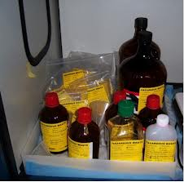
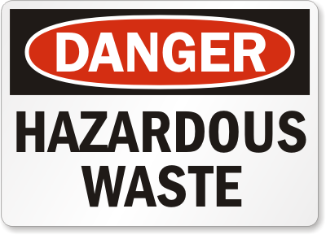
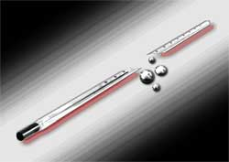
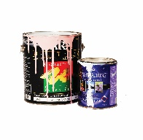

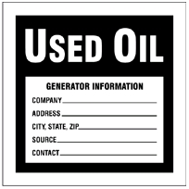
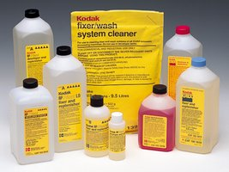
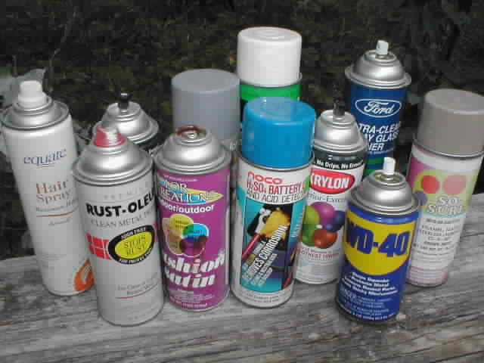
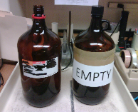
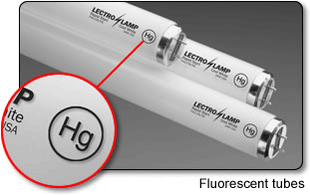
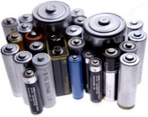
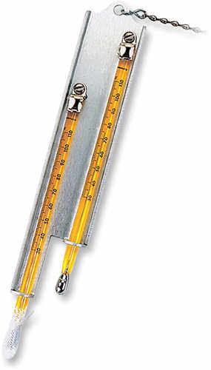
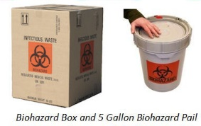
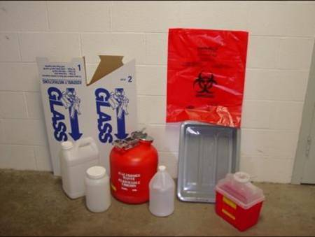
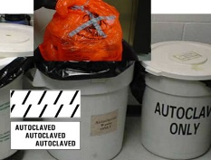
Lab Waste Types
Clearly Label
All Wastes!
Chemical Wastes:
Hazardous waste chemicals; or,
Non-hazardous chemical wastes
Special (Non-Hazardous) Wastes
Biological Wastes:
Autoclave Wastes
Biohazard (Medical)Wastes
Sharps
Other Infectious Wastes
Universal Wastes

Slide 5

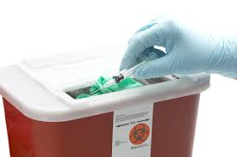
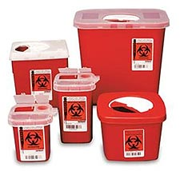
Sharps
Sharps
All sharps, including those not potentially infective or contaminated, should be put into a proper sharps container.
Do not fill the container more than ¾ full;
Do not attempt to open a closed container;
Contact the EHS Office if any injuries;
Contact the EHS Office, Lab Tech, or
Lab Manager for removal.

Slide 6

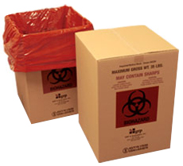
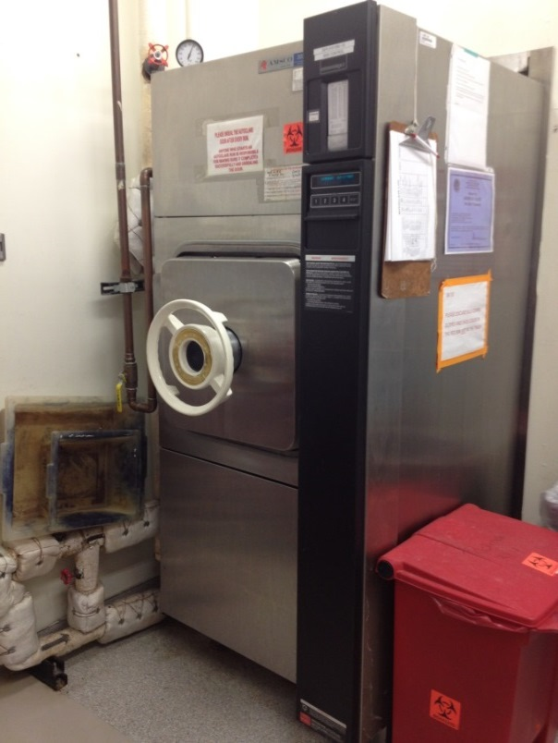
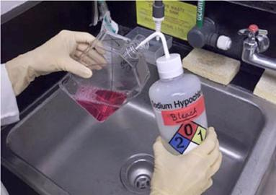
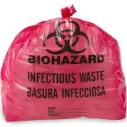
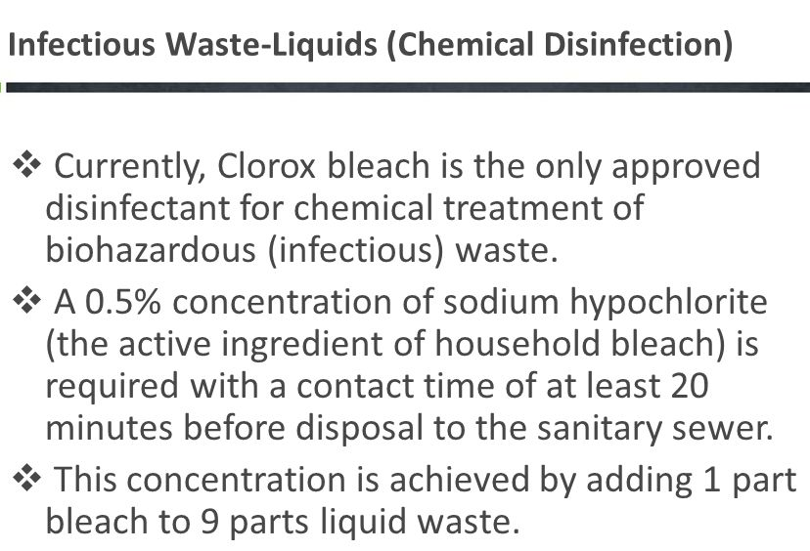
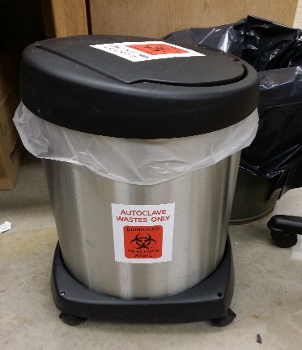
Biological Wastes
Solid wastes and absorbed liquids contained then disposed by vendor
Solids/Liquids Disposal after Autoclaving
Disinfection with 1:9 solution of bleach to water then to drain

Slide 7
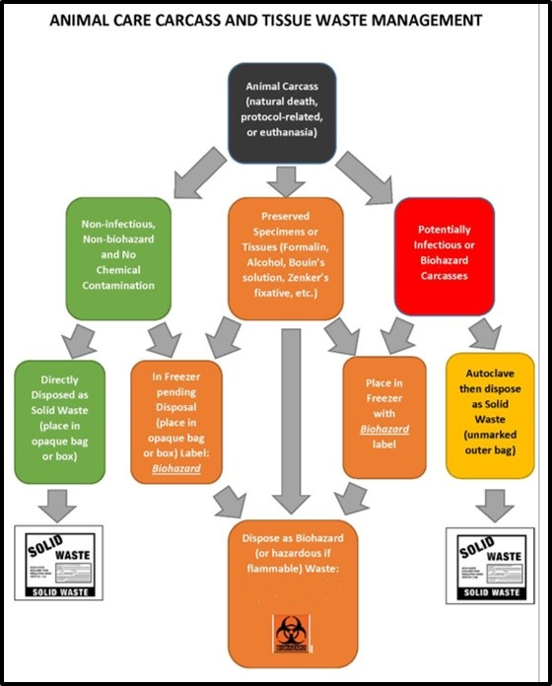
Lab Animal
Wastes and
Carcasses
The flow chart to the right illustrates the method(s) by which animal carcasses, as well as related bodily waste materials and used bedding, should be properly disposed. Uncontaminated carcasses must be securely wrapped or boxed if to be placed in solid waste dumpsters--or be transferred to the EHS Office for secure disposal.

Slide 8
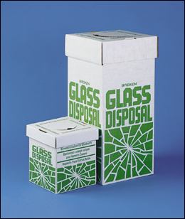
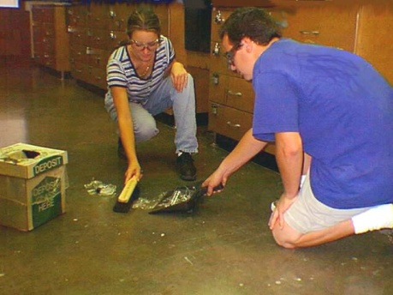
Broken Glass
Clearly label
all wastes!
All broken glass or other (non-infectious) sharp materials should be placed in a Broken Glass container.
If none are available--the broken glass should be placed in a fiber box, pail, or other protective container and labeled as “Broken Glass” and set next to, or in, a refuse container.
Do not attempt to pick up broken glass with bare hands – use leather gloves, a broom and dustpan, tongs, or other devices.
When full or ready for disposal--tape it shut and put a sign on the box for custodians to remove it.

Slide 9
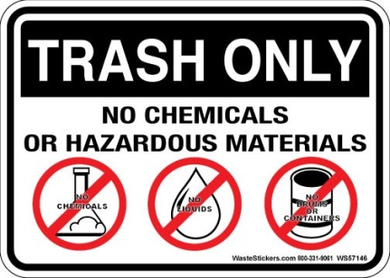


General Refuse
Do not put the afore-mentioned materials into regular refuse containers (in-room waste cans or dumpsters)
Do not put liquid wastes into the waste cans unless solidified – add absorbents (kitty litter, oil dry) if necessary.
Do not put heavy items or objects with sharp edges that may tear the container liners or injure custodians into trash receptacles.
Contact building maintenance (custodial) for any problems with regular trash pickup from building interiors (through BSU work control: 5-5081)
Do not dispose of waste chemicals or free liquids in trash containers!

Slide 10
Master Waste Flowcharts
Environmental Health and Safety Office
Ball State University

Slide 11
START HERE
Master Flowchart
Is your material a WASTE?
Refer to: Waste Definition
YES
Universal Wastes Exception - batteries, lamps, mercury, not hazardous waste
- IF to be recycled
Is your waste a SPECIAL WASTE?
Refer to: Special Waste
NO
Is your waste REACTIVE?
Refer to: Reactivity
Unless
NO
Is your waste CORROSIVE?
Refer to: Corrosives
NO
YES
YES
Your waste is:
HAZARDOUS WASTE
Contact EH&S @ 5-2807
for proper disposal
NO
Is your waste IGNITABLE?
Refer to: Ignitability
YES
Your waste is NOT a
Hazardous Waste?
NO
YES
NO
Is your waste an OXIDIZER?
Refer to: Oxidizing
YES
NO
Physical
State
Is your waste TOXIC or LISTED?
Refer to: Toxicity OR Listings
LIQUID
SOLID
NO
Consider your waste
HAZARDOUS and have a
Waste Determination
completed.
Contact: EH&S @ 5-2807
Continue to:
Drain Disposal
Deface container
label. Dispose
in regular trash
Still think your waste might be HAZARDOUS?
STOP
YES

Slide 12
Waste Definition
First, Let’s look at what are “Wastes”
START
Give the material to another
authorized laboratory or user or
send to Central Stores for excess
to be auctioned .
Can the material be used
by someone else?
YES
NO
Is the material:
Intended to be discarded ( i.e. the material
is “abandoned,” “recycled” or inherently
“waste-like”) Note: EPA views old chemicals that
have not been used in years and which are
unlikely to be used in the foreseeable future
as waste.
NO
If your material is not a WASTE,
then it is not a Hazardous Waste.
YES
Material meets the definition of WASTE
Continue on Master Flowchart

Slide 13
Special Waste Flowcharts
“Special Wastes” – are wastes that are not general refuse - but also do not rise to the level of “Hazardous Wastes”
Environmental Health and Safety Office
Ball State University

Slide 14
Special Wastes
START HERE
Is your waste RADIOACTIVE?
YES
Refer to:
Radioactive Waste Flowchart
or
Is your waste PAINT?
YES
Refer to:
Paint Waste Flowchart
or
Does your waste contain ASBESTOS?
YES
Refer to:
Asbestos Waste Flowchart
or
Is your waste a GAS CYLINDER or AEROSOL CAN?
YES
Refer to:
Compressed Gas Cylinders & Aerosols Flowchart
or
Is your waste an EMPTY CONTAINER?
YES
Refer to:
Empty Container Flowchart
or
Is your waste a METAL?
YES
Refer to:
Scrap Metal Flowchart
or
Is your waste a PHOTOGRAPHIC CHEMICAL?
YES
Refer to:
Photographic Chemicals Flowchart
or
Is your waste an OIL or ANTIFREEZE?
YES
Refer to:
Waste Oil & Antifreeze Flowchart
or
Is your waste a UNIVERSAL WASTE? (i.e.,
YES
Refer to:
Universal Waste Flowchart
NO
Material is NOT a SPECIAL WASTE.
Continue on Master Flowchart.

Slide 15
Radioactive Waste
START HERE
Is this symbol (with or without wording):
displayed on the
waste or waste
container?
or
YES
Does the waste contain any:
RADIOACTIVE MATERIAL?
Does the waste contain any isotope of an
element that undergoes nuclear
transformations emitting a form of radiation?
Your waste is a
RADIOACTIVE WASTE.
Contact EHS @ 5-2807
For further assistance
YES
YES
or
Does the waste contain any:
URANIUM or THORIUM COMPOUNDS?
(i.e., uranium dicarbide, uranium dioxide, uranium hexafluoride,
uranium hydride, uranium monocarbide, uranium tetrafluoride,
uranocene, uranyl acetate, uranyl nitrate or thorium
acetylacetonate, thorium carbide, thorium chloride,
thorium dioxide, thorium disulfide, thorium fluoride,
thorium nitrate, thorium oxalate, thorium sulfate)
or
Your waste MAY BE a
RADIOACTIVE WASTE.
Contact EHS @ 5-2807
For further assistance
Is the waste a:
Self-Illuminated Exit Sign?
Electron Capture Detector (ECD)?
YES
NO
Your waste is NOT a RADIOACTIVE WASTE.
Continue on Special Wastes Flowchart.
If you believe you still have a radioactive waste,
contact EHS @ 5-2807.

Slide 16
Paint Waste
START HERE
Is the waste:
Paint Related Waste?
(including Latex Paint, Oil Based Paint,
Lacquer Based Paint, Paint Solvents and
Thinners)
NO
Continue on
Special Wastes Flowchart
YES
Type of
Paint Related
Waste
Oil Based Paint
Lacquer Based Paint
Paint Solvents & Thinners
Latex Paint
Send to Stores as excess or
allow to dry or add absorbents
so no free liquids remain or
contact EHS @ 5-2807
for further information.
Your waste is a:
HAZARDOUS WASTE
Contact EHS @ 5-2807
to schedule a pickup.
Please note that Air Quality Regulations do
NOT allow us to dry out oil-based paints or
solvents for the purpose of disposal.
Your waste is then NOT a
Hazardous Waste and may be
disposed as regular trash

Slide 17
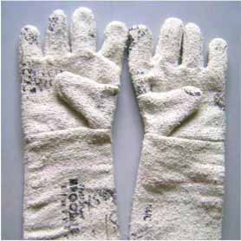
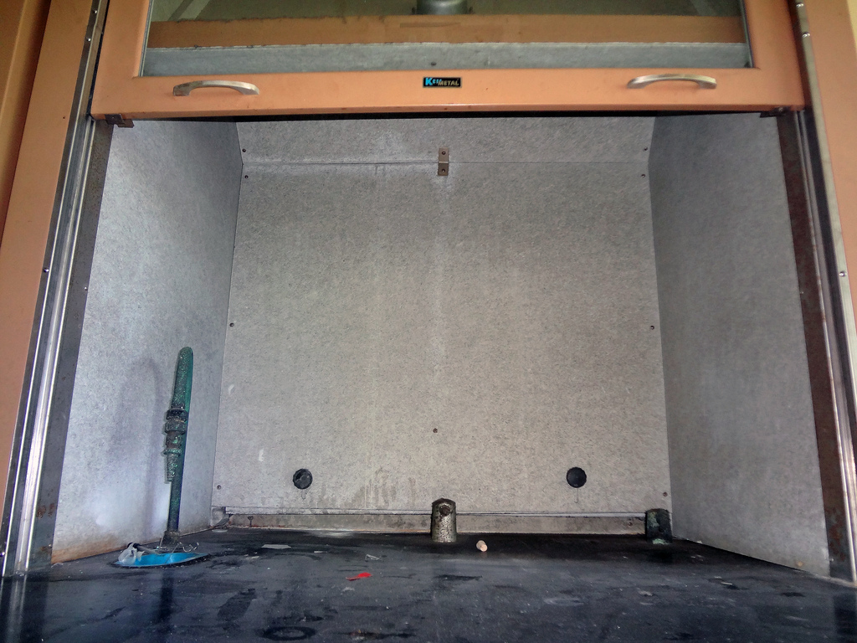
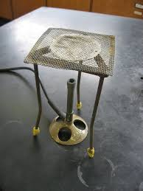
Asbestos Waste
START HERE
Does the waste:
Contain > 1% Asbestos?
Examples of Materials Commonly
Containing Asbestos (but not limited to):
• Sheet Rock Taping and Joint Compound
• Fire Door Core Material
• Roofing Felt
• Floor Tile and Mastic
• Transite Sheets (Cementitious Panels)
• Sprayed-on Ceiling Materials
• Boiler Insulation
• Pipe Insulation
• Brake Pads
• Clutch Pads
• Gaskets
• Electrical Wire Insulation
• Thermal Insulation on Electrical Appliances
Your waste is a:
REGULATED WASTE
Contact EHS @ 5-2807
to schedule a pickup
YES
NO
Continue on Special Wastes Flowchart

Slide 18
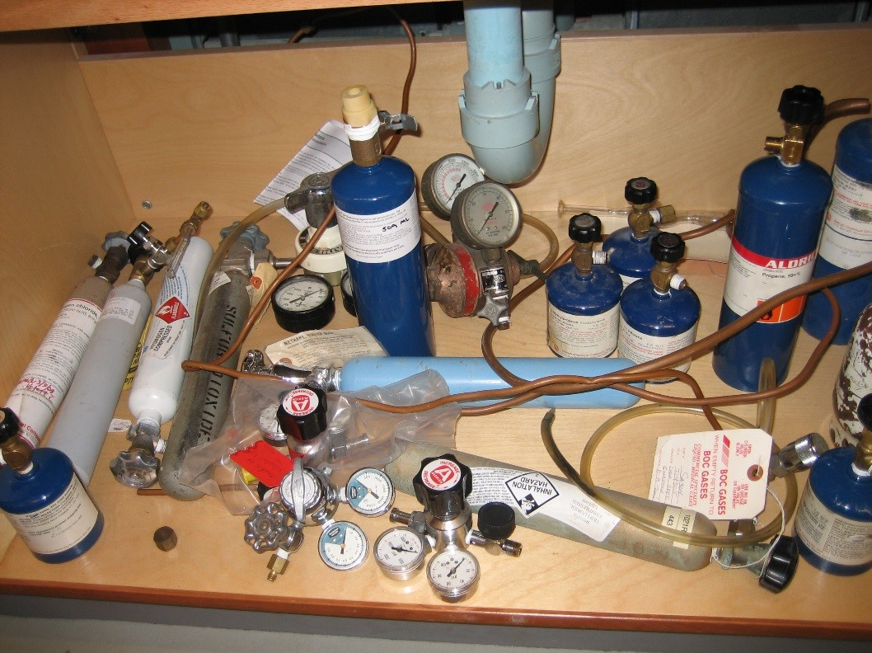
Compressed Gas Cylinders & Aerosols
START HERE
Is the waste:
An aerosol container?
YES
Is the container:
Completely emptied of the contents to the
maximum extent practical under normal use
(which is atmospheric pressure) (i.e.,
the spray mechanism is not defective)?
Your waste is a:
HAZARDOUS WASTE
Contact EHS @ 5-2807
to schedule a pickup
NO
YES
NO
Your aerosol
container even if
completely empty is then a:
HAZARDOUS WASTE
Contact EHS @ 5-2807
to schedule a pickup
Did the container:
Formerly contain a P-Listed Hazardous Waste?
(refer to P-Listed Wastes)
YES
Or
Don’t
Know
NO
Dispose of in Heath Farm metal scrap roll off
Is the waste a:
Compressed gas cylinder or a single use
propane canister?
(including gas cylinders, lecture bottles or
refillable LPG canisters)
Preferably, return the item to the supplier, or--
if the container contents can be safely discharged
and the container reduced to atmospheric
pressure--it may then be disposed as scrap metal.
If not, your waste is a:
HAZARDOUS WASTE
Contact EHS @ 5-2807 to schedule a pickup.
YES
NO
Continue on Special Wastes Flowchart

Slide 19
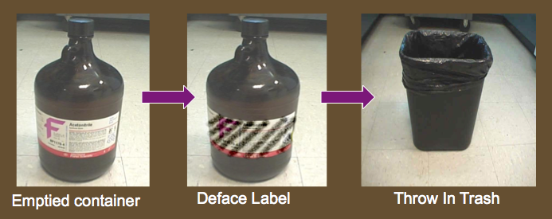
Empty Containers
START HERE
Is the waste:
An “empty” container that formerly contained a
hazardous material?
NO
Continue on Special Wastes Flowchart
YES
Does the waste:
Meet the definition of EMPTY?
For containers that held a pourable hazardous material…
No further material can be poured or drained from the
container when it is held in any orientation.
For containers that held a non-pourable hazardous material…
No hazardous material remains in the container that
can be removed by physical methods.
NO
Your waste container, even if
completely empty, is a:
HAZARDOUS WASTE
Contact EH&S @ 5-2807
to schedule a pickup
YES
Did the empty container:
Formerly contain a material that had an oral LD50 < 50 mg/kg?
(refer to the Toxicity section on Safety Data Sheet)
YES
NO
Did the empty container:
Formerly contain an Acutely Hazardous Waste?
(refer to P-Listed Waste)
YES or
DON’T
KNOW
NO
■ All containers should be triple rinsed before disposal. If the container
held a strong-smelling material, rinse with an appropriate solvent. If
the cleaning solvent is a hazardous material, collect & dispose of as
a hazardous waste.
■ Deface label and mark “triple rinsed”.
■ Recycle glass, bottles and cans where possible.
■ Under no circumstances may a container labeled with the
international radioactive symbol or with the words “Hazardous
Waste” be disposed in the regular trash.

Slide 20
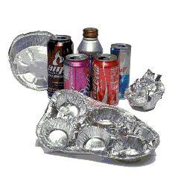
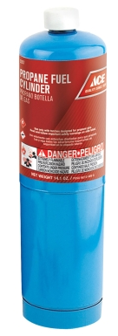
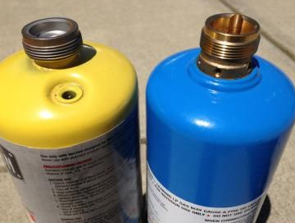
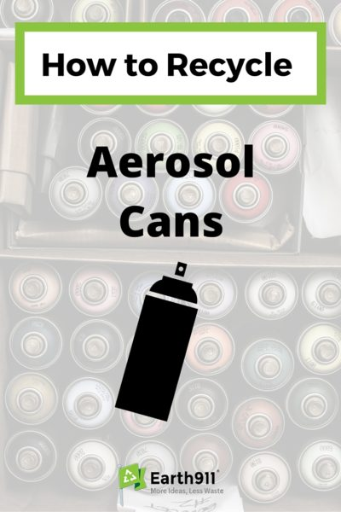
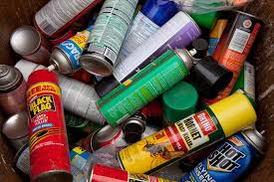
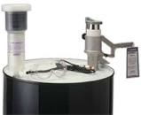
Scrap Metal
START HERE
Is the waste:
A solid metal?
NO
YES
Is the metal:
Aluminum,
Copper,
Iron,
Lead,
Steel, or
Zinc?
Your waste can’t be recycled as Scrap Metal.
Continue on Special Wastes Flowchart.
NO
YES
When you have accumulated
Aerosol cans or material,
Contact the EHS Office
to pick it up for emptying followed
By scrap metal recovery

Slide 21
Photographic Chemicals
START HERE
Is the waste:
A chemical product used for photography?
NO
Continue on Special Wastes Flowchart
YES
Unused photographic chemicals may be a:
HAZARDOUS WASTE.
Refer to the Corrosives Flowchart and
Toxicity Flowchart or
Contact EHS @ 5-2807 for assistance.
Has the photographic chemical been used?
NO
YES
Is the waste:
Fixer, Bleach-Fixer (Blix), Color Developer,
or Color Stabilizer?
Your waste should be recycled through a
silver recovery unit.
Contact EH&S @ 5-2807 for assistance.
YES
NO
Your waste is a:
HAZARDOUS WASTE
Contact EHS @ 5-2807
to schedule a pickup.
Is the waste:
Selenium Toner or Sepia Toner?
YES
NO
Is the waste:
Stop Bath or Hypo Cleaning Agent?
YES
Contact EHS @ 5-2807 to discuss disposal.
NO
Contact EHS @ 5-2807 to assist
with the proper disposal of your
photographic chemicals.

Slide 22
Waste Oil & Antifreeze
START HERE
Is the waste:
an Oil or Antifreeze?
YES
NO
Is your waste:
• Motor Oil
• Automatic Transmission Fluid
• Power Steering Fluid
• Diesel Fuel
• Gear Oil
• Vacuum Pump Oil (if uncontaminated by organics)
• Hydraulic Oil
• Fuel Oil
Oily water
• Kerosene (#3, #4, & #6)
Oils can NOT be disposed down the drain
Continue on Special Wastes Flowchart
YES
Your waste should be recycled .
Contact EHS @ 5-2807 for assistance
NO
Is your waste?
• Ethylene Glycol based Antifreeze
• Coolant from Chillers / HVAC systems
• Propylene Glycol based Antifreeze (freeze protection > 0o F)
YES
NO
Is your waste?
• Any type of oil contaminated with a hazardous chemical
• Chlorinated Solvents
• Metal working fluids
• Degreasing solvents
• Freon and Freon contaminated refrigeration oil
• Naptha
• Transformer Oil
• Radiator Flush
• Deicers
• Antifreeze with a freeze protection above 0o F
Your waste may be a:
HAZARDOUS WASTE
Contact EHS @ 5-2807
to schedule a pickup
YES

Slide 23
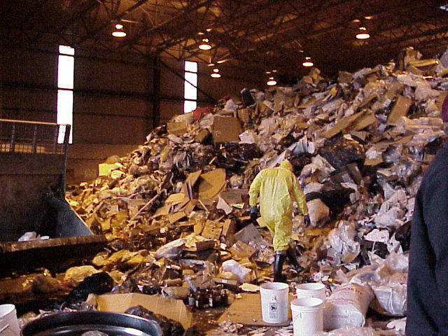
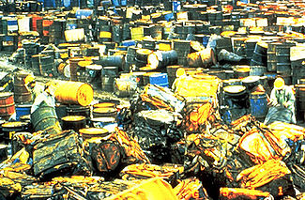
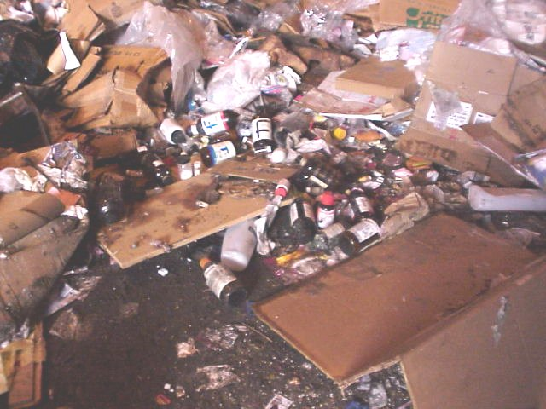
HAZARDOUS WASTES
Hazardous wastes are regulated because they present special hazards to man or to the environment if they are improperly disposed of or discarded.
The hazardous waste (RCRA) regulations are very stringent due to past chemical waste disposal abuses—the rules took effect in 1980.
The difference between a hazardous waste and a nonhazardous chemical waste can be very small – due to a physical characteristic of the waste, concentration of a constituent, the particular chemicals in the waste, or the process that generated the waste.
Misidentification of wastes:
Often leads to subsequent handling/disposal violations/penalties

Slide 24
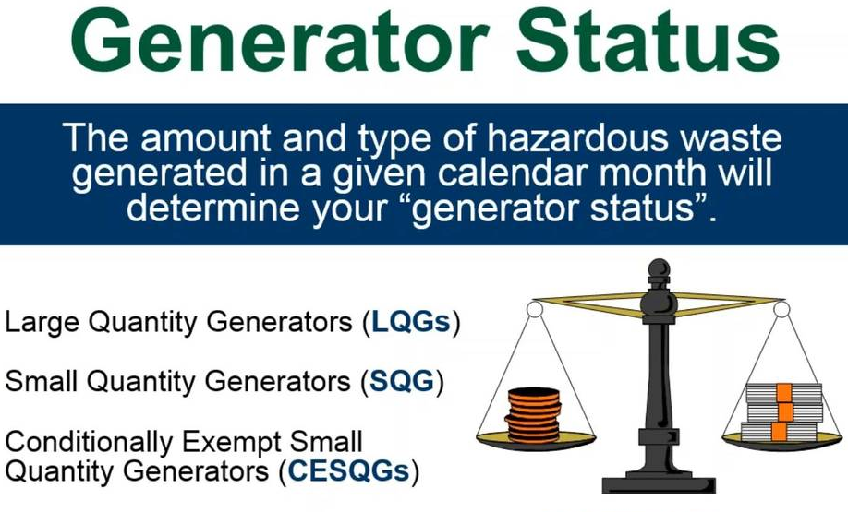
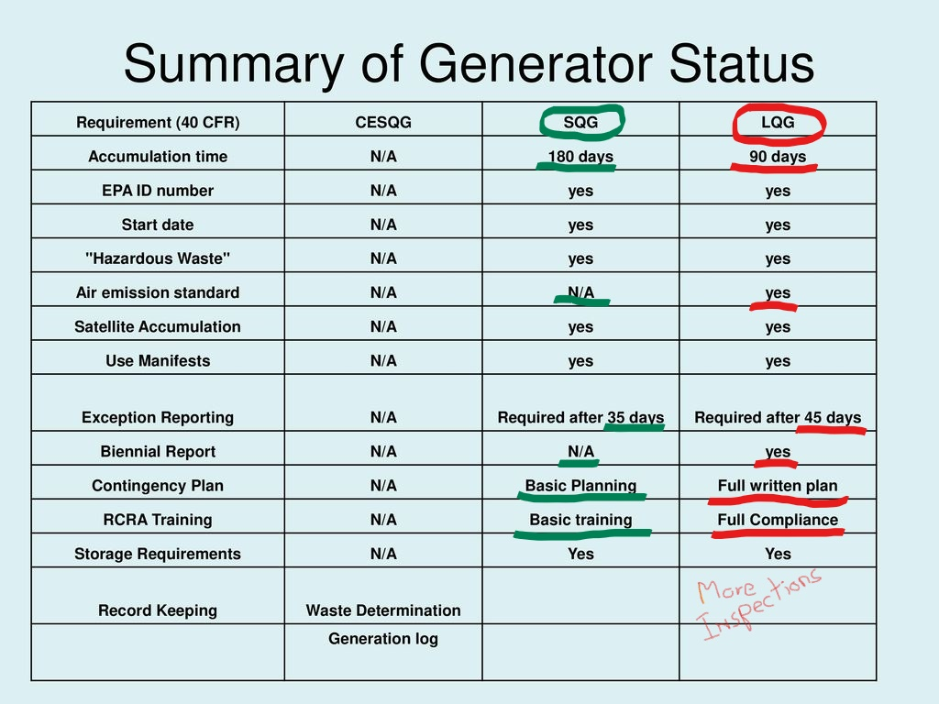
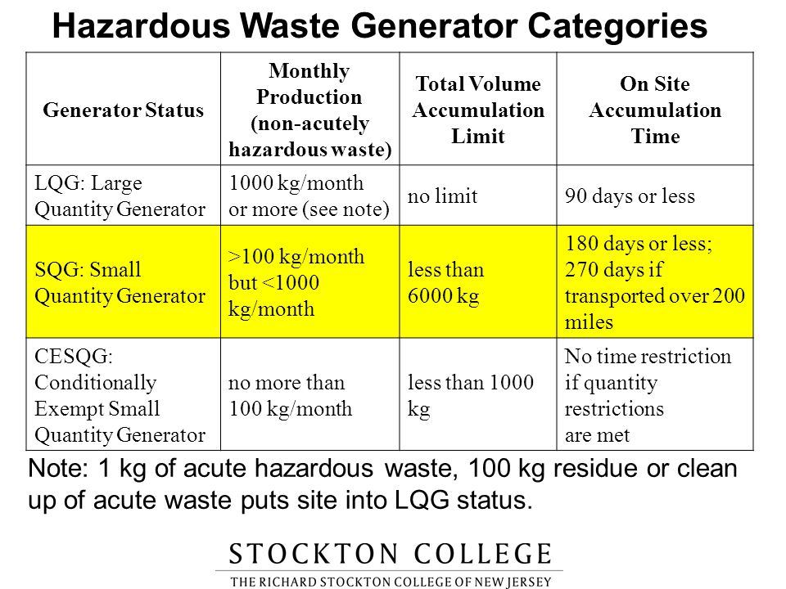
Hazardous Waste Generator Status
Ball State
More
Frequent EPA inspections
(P-listed wastes)

Slide 25
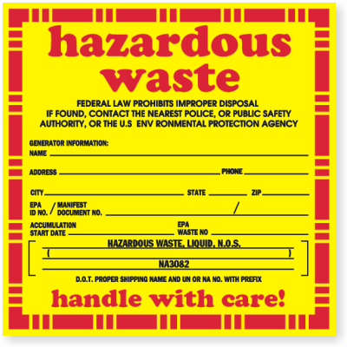

You Might Have A Hazardous Waste If ….
The Compound Or Solution meets a Characteristic of Hazardous Waste:
- Ignitable
  - Corrosive
  - Reactive
  - Toxic
Or, if it is “Listed” as a Hazardous Waste.
F | K | P | U
Non-specific Source wastes | Source- specific wastes | Acutely hazardous wastes | Toxic wastes

Slide 26

Ignitability
(D001 Wastes)
START HERE
Physical State
of
Waste
LIQUID
SOLID
Is the flash point of
the waste
(or any single phase if
multi-phase)
≤140ºF (≤60ºC)?
YES
HAZARD CLASS
IGNITABLE
Contact EHS @ 5-2807
for assistance
Is the waste:
Capable of causing fire
through friction, moisture
absorption, or spontaneous
chemical change?
YES
NO
Is the waste:
An aqueous solution
containing ≥24%
alcohol?
YES
NO
Material does NOT meet the definition of IGNITABLE.
Continue with the Master Flowchart
NO

Slide 27
Oxidizers
(also D001 Wastes)
START HERE
Does the waste:
Release oxygen when reacting with another chemical?
NO
YES
HAZARD CLASS
OXIDIZER
Contact EHS @ 5-2807
for assistance
Does the waste:
React with organic materials (i.e., oils, greases, solvents, paper,
cloth, wood, etc.) resulting in fire or the generation of heat?
YES
NO
Is the waste:
A member of one of the common oxidizer categories listed below?
or
An aqueous solution of any of the common categories listed below
which exhibits any of the oxidizing properties stated above?
YES
NO
Material does NOT meet the definition of OXIDIZER
Continue on Master Flowchart
Examples:
SOLIDS
• Bismuthates
• Bromates
• Chlorates
• Chlorites
• Chromates
• Chromium trioxide
• Dichromates
• Ferric sulfate
• Ferric chloride
• Ferric trioxide
• Ferric cyanides
• Hypochlorites
• Iodates
• Iodine
• Manganese dioxide
• Nitrates
• Perborates
• Perchlorates
• Periodic acid
• Permanganates
• Permangic acid
• Peroxides
• Persulfates
2,4-Dichlorophenol
Cellusolve
LIQUIDS
• Bromine
• Chromic acid (pH > 2)*
• Hydrogen peroxide
• Nitric acid (pH > 2)*
• Perchloric acid (pH > 2)*
• Sulfuric acid (pH > 2)*
* Oxidizing mixtures having a pH < 2 are classified as corrosive.

Slide 28
Corrosives
(D002 Wastes)
START HERE
Physical State
of
Waste
Aqueous
Liquid Waste
Non-Aqueous or
Non-Liquid Waste
Waste has:
A pH less than
or equal to 2
(pH ≤ 2)
HAZARD CLASS
CORROSIVE ACID
Contact EHS @ 5-2807
for assistance
When mixed with an equivalent
weight of water, the waste:
Produces a solution having
a pH less than or equal to 2
(pH ≤ 2)
YES
YES
NO
NO
Waste has:
A pH greater
than or equal
to 12.5
(pH ≥ 12.5)
HAZARD CLASS
CORROSIVE BASE
Contact EHS @ 5-2807
for assistance
When mixed with an equivalent
weight of water, the waste:
Produces a solution having
a pH greater than or equal to
12.5 (pH ≥ 12.5)
YES
YES
NO
NO
YES
Waste has:
The ability to cause destruction of living
tissue or steel surfaces by chemical action
NO
HAZARD CLASS
CORROSIVE
Contact EHS @ 5-2807
for assistance
Material does NOT meet the definition of CORROSIVE
Continue on Master Flowchart

Slide 29
Reactivity
(D003 Wastes)
START HERE
Does the waste:
React violently with water, or form potentially
explosive mixtures with water?
NO
YES
Does the waste:
Create toxic gases when in contact with water?
NO
YES
Does the waste:
React violently when exposed to air or form
potentially explosive mixtures with air?
YES
HAZARDOUS CLASS
REACTIVE
Contact EHS @ 5-2807
for assistance.
NO
YES
Does the waste:
Create toxic gases when exposed to air?
YES
NO
Examples include picric acid, isocyanates, cyanides, sulfides, and chlorine.
Is the waste:
Unstable (readily undergoes violent change with or
without detonating or exploding?
YES
NO
Is the waste:
A potential peroxide former that has either exceeded
its open or shelf time limits or is stored in an
undated container
NO
Material does NOT meet the definition of REACTIVE.
Continue on Master Flowchart

Slide 30

TCLP Toxicity
(D004-D043 Wastes)
START HERE
■Waste displays the toxicity characteristic if it exceeds certain
concentration levels using specified test methods.
■The toxicity characteristic leaching procedure (TCLP) is the
specified test method for determining if a waste is a toxic
hazardous waste.
The TCLP simulates the conditions in a landfill and then
analyzes the concentrations of specifically listed chemicals
and heavy metals that could potentially leach into the
groundwater.
Examples of the most common toxic materials, their
regulatory limits, and their corresponding waste codes are
listed right.
EP Toxic Hazardous Waste Examples
Arsenic
Barium
Benzene
Cadmium
Chloroform
Chromium
Lead
Mercury
Methyl Ethyl Ketone (MEK)
Selenium
Silver
Tetrachloroethylene
Trichloroethylene
Vinyl Chloride
Chloroform
5.0 ppm
100 ppm
0.5 ppm
1.0 ppm
6.0 ppm
5.0 ppm
5.0 ppm
0.2 ppm
200 ppm
1.0 ppm
5.0 ppm
0.7 ppm
0.5 ppm
0.2 ppm
6.0 ppm
D004
D005
D018
D006
D022
D007
D008
D009
D035
D010
D011
D039
D040
D043
D022
NOTE: The 8 compounds that appear in boldface
are referred to as the “RCRA 8 metals” and are
among the most common toxic wastes generated
at Ball State.
Material does NOT meet the definition of TOXICITY.
Continue on Master Flowchart

Slide 31
Listed Wastes
START HERE
The EPA has already determined that certain chemicals are hazardous when they are to be
disposed. These include some spent solvents, pharmaceuticals, precursors, or byproducts
in chemical manufacturing. These listed wastes are found in four separate tables depending
on their source or degree of hazard or toxicity. Each listed waste has a hazardous waste
number which starts with the letter F, K, P, or U.
The K wastes result from specific production or waste treatment processes common in
industry. These are not normally generated in laboratories, art studios or workshops and
will not be further discussed here.
K | F | P | U
Source- specific wastes | Non-specific Source wastes | Acutely hazardous wastes | Toxic wastes
Material does NOT meet the LISTING criteria.
Continue on Master Flowchart

Slide 32
F Listed Wastes
START HERE
F-listed hazardous wastes are non-source specific wastes that are generated by common
processes that can occur in various applications, including processes that generate spent
solvents, electroplating and other metal finishing processes. F-listed wastes often found in
laboratories and art studios include, but are not limited to, the following solvents or mixtures
Containing ten percent (10 %) or more of such solvents before use.
1,1,1- trichloroethane | 1,1,2- trichloroethane | 2-ethoxyethanol | 2-nitropropane | Acetone
Benzene | Carbon disulfide | Carbon tetrachloride | Chlorinated fluorocarbons | Cresols
Cresylic acid | Cyclohexanone | Ethyl acetate | Ethyl benzene | Ethyl ether
Isobutanol | Methanol | Methylene chloride | Methyl ethyl ketone | Methyl isobutyl ketone
n-Butyl alcohol | Nitrobenzene | Ortho­dichlorobenzene | Pentachlorophenol | Pyridine
Tetrachloroethylene | Toluene | Trichloroethylene | Trichlorofluoro- methane | Xylene
  Spent solvent wastes (F001 - F005).
  Wastes from electroplating and other metal finishing operations (F006 - F012, and F019)
Material does NOT meet the LISTING criteria.
Continue on Master Flowchart

Slide 33

P- and U- Listed Wastes

Slide 34
START HERE
P Listed Wastes
The P-listed (acute) hazardous wastes are commercial grade formulations of specific unused
chemicals. Unused chemicals may be considered wastes because they are no longer
needed, they are spilled, or they are off-specification. Laboratories are the usual source of
These chemical wastes that are subject to more stringent regulations. There are over 200
P-listed wastes and containers that held these wastes must be disposed as hazardous
waste as well. The most common P-listed chemicals generated at Ball State include:
Acrolein | Allyl alcohol | Ammoniumvanadate | Arsenic acid | Brucine
Carbon disulfide | Chloro acetaldehyde | Chloroaniline | Cyanides | Diisopropyl fluorophosphate
2,4-Dinitrophenol | p-Nitroaniline | Phosgene | Potassium cyanide | Sodium azide
Sodium cyanide | Thallium oxide | Vanadium pentoxide | Epinephrine | Nicotine & salts
Osmium tetroxide | Fluoroacetic acid | Thallium oxide | Fluorine | Parathion
They must meet the following criteria: (1) The formulation must contain at least one chemical on the P-list; (2) The chemical in the waste must be unused; and (3) the chemical in the waste must be in the form of a commercial chemical product (CCP), which is a chemical that is of technical (commercial) grade, 100% pure, and the only active ingredient in the formulation.
Material does NOT meet the LISTING criteria.
Continue on Master Flowchart

Slide 35
START HERE
U Listed Wastes
The U-listed (toxic, but not acutely) hazardous wastes are commercial grade formulations of
Specific unused chemicals. Unused chemicals may be considered wastes because they are
no longer needed, spilled or off-specification. There are over 300 U-listed hazardous wastes.
Those most likely found in our laboratories include the following:
Acetaldehyde | Pyridine | 2-Propanone | Acetone | Acetonitrile
Cacodylic acid | Acrylamide | Acrylonitrile | Aniline | Benzene
1-Butanol | Chlorobenzene | Chloroform | Hydrofluoric acid | Cresol
Cyclohexane | Cyclohexanone | Dichlorobenzene | Ethylene dichloride | 1,2- Dichloroethylene
Methylene chloride | 2,4-Dichlorophenol | 1 ,4-Dioxane | Ethyl acetate | Ethyl ether
Trichloromonofluoromethane | Formaldehyde | Formic acid | Hydrazine | Isobutyl alcohol
Lead acetate | Mercury | Methanol | Methyl ethyl ketone | Methyl isobutyl ketone
Triethylamine | Methyl methacrylate | Naphthalene | Phenol | Resorcinol
1,1,1,2- Tetrachloroethane | 1,1,2,2- Tetrachloroethane | Tetrachloroethylene | Carbon tetrachloride | Tetrahydrofuran
Trypan blue | Thiourea | Toluene | Xylene | Trichloroethylene
If material does NOT meet the LISTING criteria.
Continue on Master Flowchart
Like the P-listed wastes, the U-wastes must meet the same 3 criteria – be the only active ingredient, unused, and technical grade or off-specification product.

Slide 36
START HERE
Drain Disposal
Is the waste: A Liquid?
Waste CANNOT go down the drain.
NO
YES
Does the waste:
Contain any Radioactive Material?
Waste CANNOT go down the drain.
Waste is a RADIOACTIVE waste
YES
NO
Does the waste:
Contain oils, fats, or grease?
Waste CANNOT go down the drain.
Waste is probably a Muncie F.O.G. Waste
YES
NO
Does the waste:
Contain significant toxics? (alcohols >
24%, metals, or other toxics?
Waste CANNOT go down the drain.
YES
NO
Waste CANNOT go down the drain.
Waste is a Hazardous Waste.
Cannot neutralize, unless documented
part of experimental procedure.
Contact EHS @ 5-2807 for approval.
Does the waste have a:
pH ≤ 5.0 or pH ≥ 9.5 ?
YES
NO
Does the waste have a:
pH ≥ 5.0 and pH ≤ 9.5?
(a strong acid or base more dilute than 0.01N)
Lab may be able to drain dispose as long as there
are no heavy metals or other hazardous
constituents.
Not sure contact EHS @ 5-2807 for confirmation.
YES
Go back to MASTER FLOWCHART

Slide 37

Hazardous Wastes vs. Universal Wastes: An Exception
START HERE
Is the waste: A battery, lamp,
mercury-containing equipment,
or pesticide?
NO
Go to the Special Wastes Flowchart
YES
Is the waste (not leaking or damaged)?
• Intact Lead Acid, Ni-Cd, Lithium, Silver
Oxide, Mercuric Oxide Batteries
• Intact fluorescent, incandescent, HID,
sodium, mercury, metal halide, neon lamps
• Intact Mercury-containing equipment
Your universal wastes should be recycled
According to the universal waste regulations.
Contact EHS @ 5-2807 for assistance.
YES
NO
Is your waste (leaking/damaged)?
• Broken or leaking batteries
• Deliberately crushed, broken lamps
• Pesticides in non-usable condition
• Broken or leaking mercury-containing
equipment - thermometers, barometers, etc.
Your waste is a:
HAZARDOUS WASTE
Contact EH&S @ 5-2807
to schedule a pickup
YES
NO
These wastes have lesser requirements--if they are to be recycled. They must be labeled as “Universal Wastes” and be removed for recycling within one year of their accumulation or “removal from service”.
Is your waste: Alkaline Battery
YES
These are non-hazardous and can be
placed in the regular trash, however, in an
effort to become environmentally friendly
you may choose to collect these batteries in
a 1-gallon container for recycling purposes.
Contact EHS @ 5-2807 to obtain
containers and request pickups.

Slide 38

Caution: Mixing Wastes
If you mix a hazardous waste with a nonhazardous waste-- you may be making the entire mixture a hazardous waste.
If you mix a listed hazardous waste with a nonhazardous waste (or a characteristic hazardous waste) you will be making the entire mixture a listed hazardous waste.

Slide 39
RCRA Subpart K
Because teaching and research labs differ from industry in the following ways:
  Hazardous waste generation pattern is different:
    Hundreds of different hazardous wastes that vary over time
    Small amounts of each hazardous waste
    Many individuals generating hazardous waste in many labs (i.e., many points of generation)
  The persons generating the hazardous waste are often students, who:
    Have inherently high turnover (thus difficult to train)
    Lack the expertise or interest mandated in industry
Ball State University decided to have the main campus covered by Subpart K of the RCRA hazardous waste regulations - an alternative regulation designed specifically for academic laboratories that became available in 2008.

Slide 40


Lab Wastes and RCRA Subpart K
The provisions of Subpart K are intended to bring about safer management of hazardous waste in academic laboratories:
Allows hazardous waste determinations to be made by “trained professionals”--rather than by all students, faculty, or researchers.
Mandates training for “lab workers” and students: Must be only sufficient for you to understand and implement the requirements of Subpart K by following Ball State’s Laboratory Waste Management Plan.
Requires a university-specific Laboratory Waste Management Plan to be developed and followed (available on EHS website).

Slide 41

Ball State Laboratory Waste Management
Allows eligible academic entities the flexibility to decide when
and where on-site hazardous waste determinations are made.
Offers incentives for removing old and expired chemicals that may pose risks from the laboratories—Lab Cleanouts.
It is this approach (Subpart K) that is described in the following slides for the identification and handling of hazardous wastes from labs and studios.
This system removes the responsibility for making the hazardous waste determination from the lab worker or student in the lab and places it in the hands of a “trained professional”--IF the following procedures are followed:

Slide 42

Lab Wastes
Chemical Lab Wastes Can be Either:
Non-hazardous Wastes;
or
Hazardous Wastes
This determination will be made
by a “trained professional”
based on the completed waste
label.

Slide 43


Lab Wastes: the Container Label
Completing the BSU Lab Waste form meets all of the EPA container label requirements
Our BSU label also has a space for either the lab, or “trained professional” to mark whether the waste is a Hazardous Waste

Slide 44

Lab Waste Label:
Example
Start Date – date when lab (or studio) waste is first added to container (if combining containers – the earliest date prevails), or the date decision is made the material in the container is unwanted and is to be discarded.
Contact person – who generated or knows the nature of the waste?
Give common waste name;
Provide contents and estimated percentage;
Check known/likely hazards; and,
If known, check if a hazardous waste
.

Slide 45




Lab Waste Label:
Hazard Checklist
Toxin/Poison: A waste that either exhibits Toxic hazards as defined below, or is otherwise designated a Poison based on shipping labels on the constituent containers, on Safety Data Sheets, or container labels related to the contents of the waste container.
Toxic: A waste having the capacity to cause death, illness, or diminished function. A material that meets one or more of the following criteria should be considered toxic:
Has a published oral LD₅₀ equal to or less than 300 mg/kg of body weight.
Has a published dermal toxicity LC₅₀ equal to or less than 1000 mg/kg.
Has a published inhalation toxicity below: 0.5 mg/L for dusts and mists; 500 ppm/V gases; or 2.0 mg/L for vapors.

Slide 46




Lab Waste Label:
Hazard Checklist
Heavy Metal: This refers to the 8 RCRA metals – Arsenic (As), Barium (Ba), Cadmium (Cd), Chromium (Cr), Mercury (Hg), Lead (Pb), and Selenium (Se), and Silver (Ag). If present in the waste in appreciable amounts, name the metal and its approximate concentration in mg/L or percent.
Flammable: Liquids having a flashpoint of less than 140°F. For solids--may cause a fire through friction; show a burning rate faster than 2.2 mm (0.087 inches) per second; or any metal powders that can be ignited and react over the whole length of a sample in 10 minutes or less. Naphthalene, matches, aluminum powder, calcium flakes, and magnesium are examples of flammable solids.

Slide 47






Lab Waste Label:
Hazard Checklist
Oxidizer: Any compound that spontaneously evolves oxygen at room temperature or under slight heating. The term includes such chemicals as chlorates, perchlorates, nitrates, and permanganates. Peroxide-formers should be checked separately where indicated lower on the label.
Pharmaceutical: Note if the waste is a pharmaceutical that may require special disposal considerations – controlled substance, recalcitrant to treatment, etc.
Corrosives: Acids and bases or mixtures having a pH less than
or equal to 2, or greater than or equal to 12.5, and materials
that burn the skin or dissolve metals. Examples are strong mineral acids (chromic, sulfuric, hydrochloric, or nitric) strong alkalis (potassium hydroxide, sodium hydroxide), rust removers, and acid or alkaline cleaning fluids. Specify the pH of the waste where indicated if known or a potential hazard.

Slide 48



Lab Waste Label:
Hazard Checklist
Listed Constituents: Identify any RCRA “Listed” waste constituents in the waste – either the F-list, or P, or U-listed wastes– only if the P or U-listed waste is the sole active ingredient in the chemical product/waste.
Reactivity: A waste material, other than an explosive, which will vigorously polymerize, decompose, condense, or become self-reactive and undergo other violent chemical changes, including explosion, when exposed to heat, friction or shock, or in the absence of an inhibitor, or in the presence of contaminants or in contact with incompatible material. Check if the material is air or water reactive or shock sensitive. Also, check and provide the concentration of any cyanides or sulfides in the waste. a waste is hazardous if it is a cyanide- or sulfide-bearing waste which generates toxic gases or vapors at a quantity sufficient to present a health or physical danger.

Slide 49





Lab Waste Label:
Hazard Checklist
Carcinogen: Any substance or agent capable of causing or producing cancer in mammals, including humans. A chemical is considered to be a carcinogen if it has been listed as such by the International Agency for Research on Cancer (IARC), by the National Toxicology Program (NTP) (latest edition), or if it is regulated by OSHA as a carcinogen.
Irritant: A chemical/material that causes a reversible inflammatory effect on living tissue, and may cause soreness, redness or discomfort.
Sensitizer: A chemical that causes a substantial proportion of exposed people or animals to develop an allergic reaction in normal tissue after repeated exposure to the chemical.

Slide 50


Lab Waste Label:
Hazard Checklist
Solvents: Identify if the waste contains materials that were used as a solvent or extraction fluid – either halogenated (methylene chloride, chloroform, trichloroethylene, dichloroethylene, tetrachloroethylene, 1,1,1-trichloroethane, carbon tetrachloride, chlorinated fluorocarbons, etc.); or non-halogenated (Xylene, acetone, ethyl acetate, ethyl benzene, ethyl ether, methyl isobutyl ketone, n-butyl alcohol, cyclohexanone, and methanol, etc.)
Peroxide Formers: Organic peroxides are very unstable carbon-based chemicals that contain the characteristic peroxide (-O-O-) bond. Peroxides can be formed when commonly used laboratory chemicals with the potential to form peroxides react with air, moisture, or impurities. Organic peroxides are extremely sensitive to shock, sparks, heat, friction, impact, and light. These include acrylonitrile, butadiene, cyclohexene,, ethylene glycol diethyl ether, furan, isopropyl ether, methyl isobutyl ketone, vinyl acetate, vinyl chloride, and vinyl ethers.

Slide 51


Lab Waste Label:
Hazard Checklist
Biohazard: An agent of biological origin (e.g., all infectious organisms, their toxins, allergens of biological origin, and genetic fragments) that has/have the capacity to cause ill-effects in humans.
Explosive: The term "explosive" or "explosives" includes any chemical compound or mechanical mixture which, when subjected to heat, impact, friction, shock, detonation or other suitable initiation, undergoes a very rapid chemical change with the evolution of large volumes of highly heated gases which exert pressures in the surrounding medium. The term applies to materials that either detonate or deflagrate. Explosive wastes do not appear as a label hazard as such materials should be immediately brought to the attention of the BSU EHS Office for proper handling.
Other: Can include any other hazard not listed.

Slide 52



Lab Waste Label:
Hazard Checklist
OR
Hazardous or Non-Hazardous: Many chemicals and compounds would not constitute hazardous wastes, a few examples include neutralized caustics (pH between 5 and 10), collagen, cytosine, nutrients, starches, cellulase, many biologicals and media, salines, potassium thiosulfate, plasmin, calcium citrate, pectrin, and many others. If a trained individual, based on knowledge of the waste contents and characteristics can determine that the waste is not a RCRA Hazardous Waste, this class may be checked. Normally, this determination will be made following removal of the waste by the Chemical Hygiene Officer or field chemists employed by BSU’s waste vendor personnel. However, if you believe the waste is innocuous it may be checked as Non-Hazardous here--or separately disposed as solid waste or to the sewer as described in the BSU Waste Management Guide.

Slide 53

Lab Wastes:
Checklist
1. Label properly!
2. Use compatible containers in good condition;
3. Do not exceed 55 gallons (220 lbs) of waste in any one lab (1 qt. of P-lists);
4. Do not exceed 6 months beyond the start of accumulation date;
5. All personnel and students in labs must have basic training;
6. Only fully “trained persons” may remove the wastes or make hazardous waste determinations
7. EHS has ten (10) days to remove the wastes after container is full or 6 months.

Slide 54

Lab Wastes:
Checklist
8. Be sure all waste containers are always kept closed; EXCEPT:
When adding, removing, or bulking Lab Wastes; or,
A Working Container may be open until the end of the procedure or work shift (must then be closed); or,
When venting of a container is necessary;
For the proper operation of lab equipment – i.e., in-line collection of waste from HPLC; or,
To prevent dangerous situations, such as build-up of pressure; and,
Must be 2 gallon or less capacity.

Slide 55


Lab Wastes:
Laboratory Cleanouts
Subpart K allows a particular laboratory a “once per year” Laboratory Cleanout;
Best to keep chemicals in their original manufacturer’s container;
Only allowed one per rolling 12-month period;
EHS has 30 days (rather than 10 days) from the time the cleanout begins to remove the chemicals from the laboratory;
The laboratory department can perform the cleanout --- or schedule it for EHS and our waste vendor to perform;

Slide 56

Lab Wastes:
Lab Cleanouts
Required Laboratory Cleanout
Documentation – must:
Identify the lab/room being cleaned out;
Provide a listing or inventory of the chemicals removed;
The date(s) the laboratory clean-out begins and ends;
The total volume of hazardous waste generated;
These records must be kept for at least 3 years.
If done properly, the increased waste volume will not affect our hazardous waste generator status.

Slide 57

Lab Wastes:
Responsibilities
Remember:
It is the responsibility of the student, laboratory worker, instructor, Principal Investigator, or manager within the laboratory, studio, or workshop to prepare the label(s) completely and verify that labels are placed on all containers of lab wastes stored in the laboratory, or associated storage or preparation room.
In order for the container to be removed from a laboratory or studio it must be identified with the required information.

Slide 58


Lab Waste Pick-Up Schedule
The EHS Office schedules waste pickups across the campus on a bi-monthly schedule:
However, BSU maintains a Central Waste Accumulation Area for the temporary storage and staging of Lab Wastes between the scheduled pickups for off-site treatment and disposal.
Call the BSU EHS Office for pickup of waste of any type whenever necessary – 5-2807 or trhunt@bsu.edu

Slide 59
10 BASIC RULES OF HAZARDOUS
WASTE MANAGEMENT:
6. Keep containers closed at all times except filling/emptying.
7. DO NOT dispose of hazardous waste in the trash, down drains, or evaporate in fume hoods.
8. Maintain emergency equipment and know what to do in the event of a spill, fire, release or explosion.
9. Use pollution prevention techniques to minimize amounts of chemical waste.
10. If you feel the waste should be handled as hazardous waste—mark that on the LAB WASTE label.
Use proper containers – size and material compatibility.
Complete and affix the LAB WASTE label upon first use or upon deciding to dispose an obsolete chemical or product.
Normally, keep separate wastes in separate containers-- or make sure compatible!
Use secondary containment for liquids kept near drains or incompatible chemicals.
Segregate all containers by hazard class.

Slide 60

Questions?
Contact:
Terry Hunt
Chemical Health and Safety Officer
Environmental Health and Safety Office
Ball State University
321 North College Avenue
Muncie IN 47306
765-285-2807 or trhunt@bsu.edu
And/or visit the Ball State University EHS Website to review laboratory safety and related waste handling information

