Slide 1
Welcome! Before starting the presentation…
At the top of the screen you will see the yellow bar noting a protected view. Click your mouse on “enable editing.”
A security warning will then come up and you’ll need to click on “enable content.” Doing so should allow the You Tube video to be played later in the presentation.
Click on Slide 2 to start the presentation.

Slide 2


BLOODBORNE PATHOGENS
Environmental Health & Safety
Brandon Clidence

Slide 3
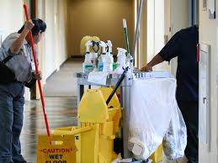
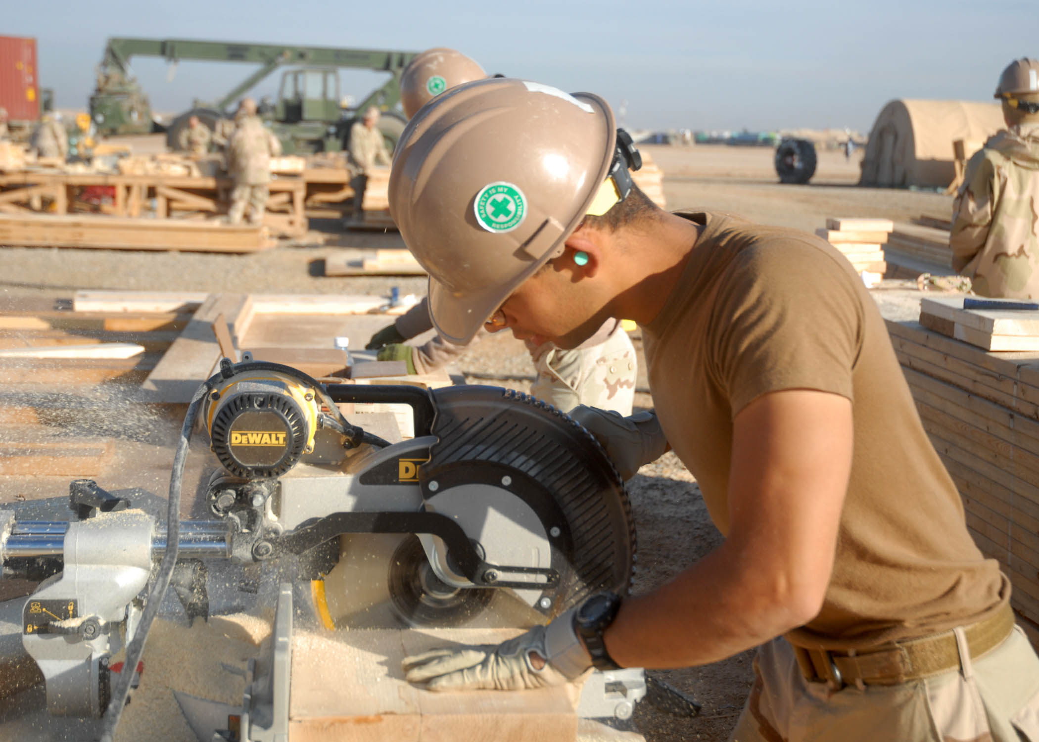


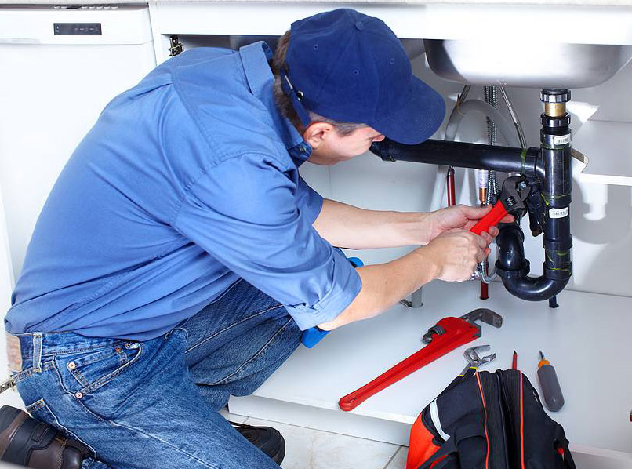
Workers can be exposed to BBP in a variety of occupations

Slide 4
BB Pathogen 29 CFR 1910.1030
Major purpose of the Standard is to prevent the transmission of bloodborne diseases within the workplace
With the potential hazards associated with bloodborne diseases, the Occupational Safety and Health Administration (OSHA) implemented The Bloodborne Pathogens Standard 29 CFR 1910.1030

Slide 5
OSHA 29 CFR 1910.1030
OSHA’S BBP STANDARD
Protects those workers who can reasonably expect to come into contact with blood or OPIM (other potentially infectious materials) while doing their job
  OPIM which includes semen, vaginal secretions, cerebrospinal fluid, synovial fluid, pleural fluid, pericardial fluid, peritoneal fluid, amniotic fluid, saliva in dental procedures, any body fluid that is visibly contaminated with blood, and all body fluids in situations where it is difficult or impossible to differentiate between body fluids

Slide 6

BBP Plan is….
Modeled after OSHA Plan
Reviewed annually
Available at Risk Management/EHS website

Slide 7

Departments/Groups with Potential Exposure
Alumni Center Custodians
Athletics Custodians
Athletic Training Staff
Burris School Nurse & Indiana Academy Nurse/SLP’s
Mitchell Early Childhood & Family Center- Students
Dining Supervisors, Concept, Group Leaders, Custodians
Environmental Health & Safety- Public Health Specialist, Environmental Specialist
Facilities, Planning & Management- Plumbers, Welders, Custodians
Human Performance Lab Technicians, Staff, Graduate Assistants
Landscape Services
Public Safety Department- Police
School of Nursing Faculty, Graduate Assistants
Student Center and Hotel Custodians
University Housing Custodians

Slide 8

HEPATITIS B VACCINATION
According to World Health Organization (WHO), protection lasts at least 20 years and is probably lifelong
Usually a 6 month process with 3-4 shots
Offered at University Health Center at no cost to employees that are potentially exposed

Slide 9
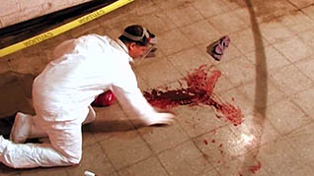
BLOODBORNE PATHOGENS (BBP) ARE….
…infectious microorganisms in human blood and other body fluids that can cause disease.
…agents that can cause serious or life-threatening illness.

Slide 10
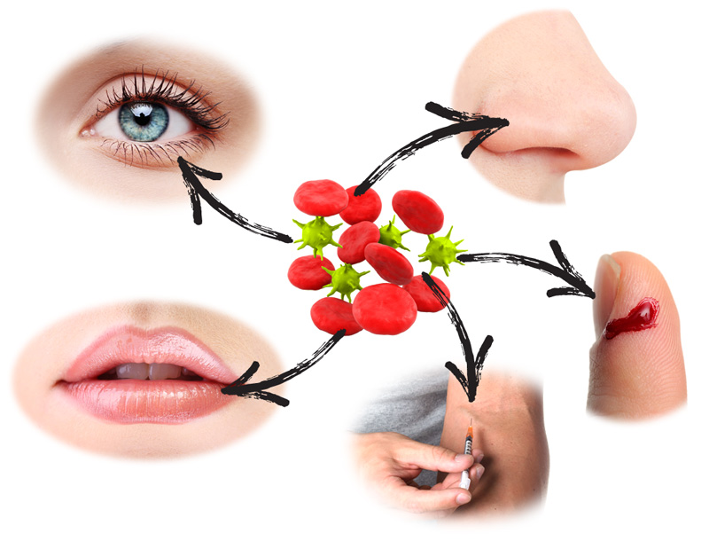
WHAT DEFINES EXPOSURE?
    Contact of the eyes, nose, mouth, non-intact skin, other mucous membranes
    Open areas of the skin- cuts, dermatitis, chapped skin, etc.
    Parenteral contact- Cuts or sticks/punctures
    from other sharp instruments contaminated with infectious blood

Slide 11
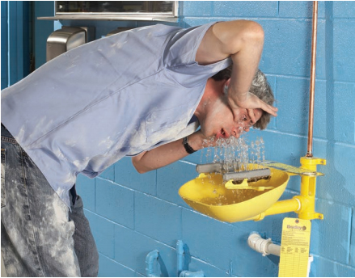
EXPOSURE INCIDENTS
          Immediately wash hands and other skin surfaces with soap and water
Eye exposure should be flushed with clean water or sterile saline
Mouth exposure should be flushed with plain water or mouthwash while nose exposure should be flushed with water
Report any exposure to potentially infectious material immediately to your supervisor

Slide 12

POST-EXPOSURE
Medical Evaluation
Vaccination if desired and not already
vaccinated (Hep B only)
No cost to the employee
Prompt medical evaluation may reduce the risk of acquiring and transmitting disease

Slide 13
THINGS TO CONSIDER WHEN DETERMINING RISK OF EXPOSURE
Exposed blood must be infected with a BBP
Exposure type (cut in skin, needlestick, etc.)
Amount of blood involved in the exposure
Amount of the disease in the blood at time of exposure
Open sores, cuts, or rash on your skin
Person must be susceptible to the disease

Slide 14

THREE DISEASES MENTIONED IN OSHA PLAN
HEPATITIS B
HEPATITIS C
HIV/AIDS

Slide 15

HEPATITIS B
Hepatitis means inflammation of the liver
Viral infection that attacks the liver causing acute (new) infection or chronic (unable to get rid of the virus after 6 months) infection
Symptoms generally appear 3 months after exposure but can appear from 3 weeks to 6 months after exposure
Can survive outside the body for up to 7 days

Slide 16
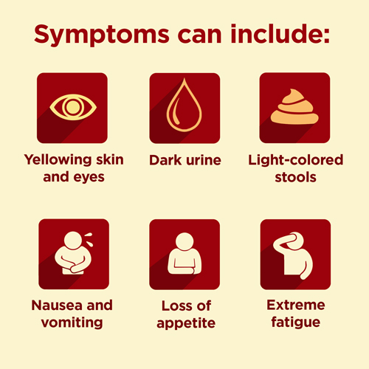

Slide 17
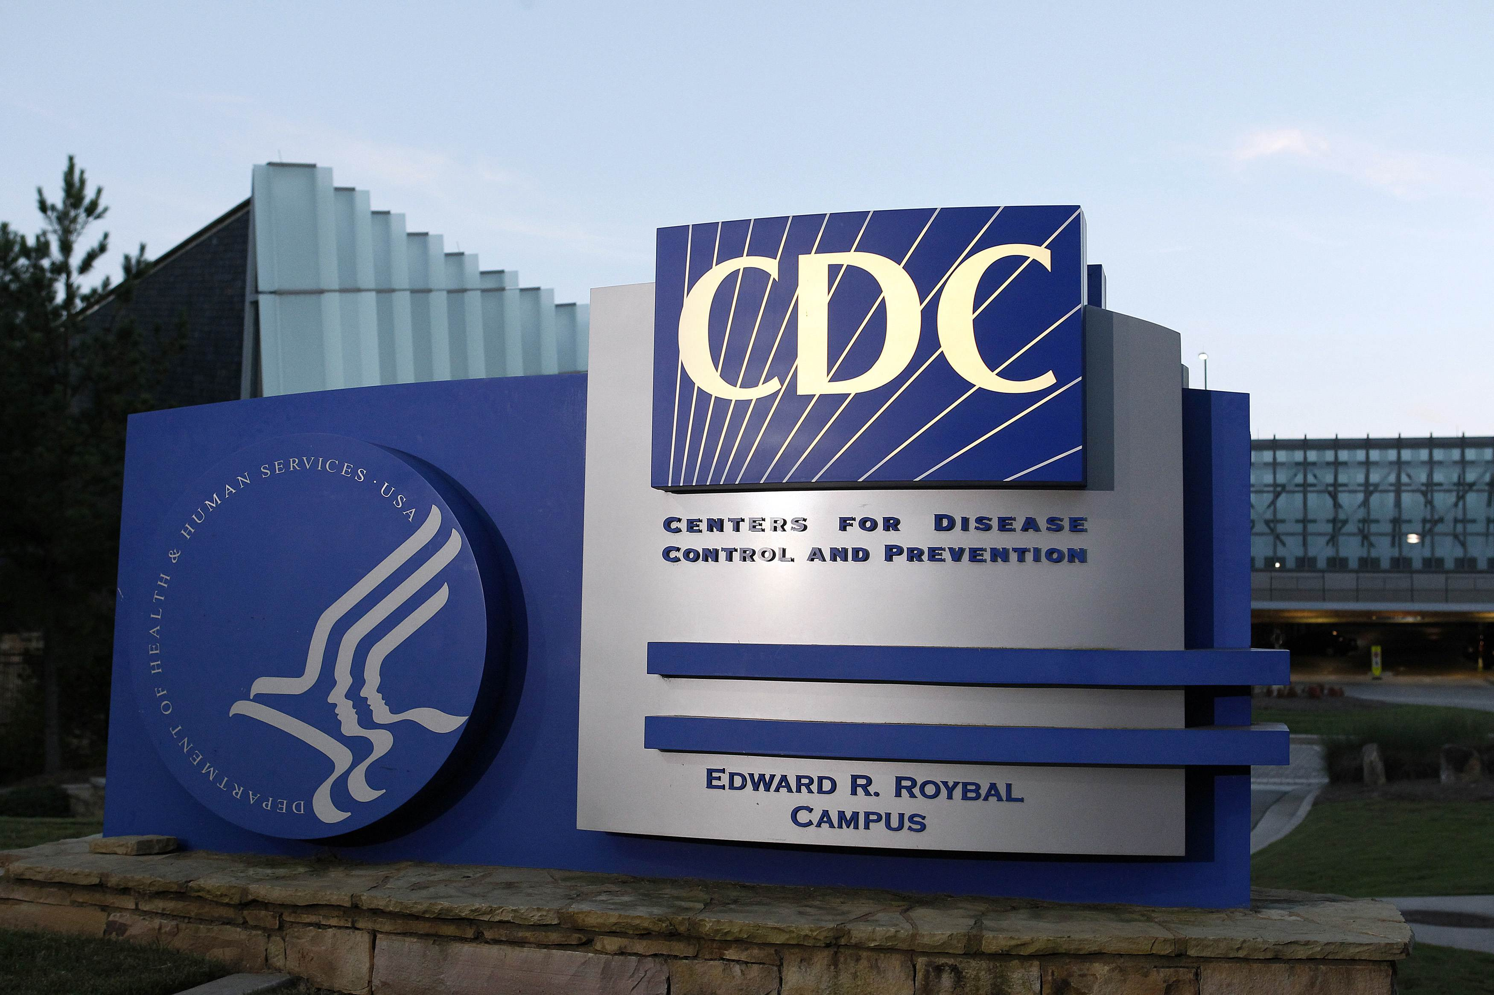
HEPATITIS C
The most common bloodborne infection in the U.S.
75-85% of those infected will develop chronic Hep C
70-80% show no symptoms

Slide 18
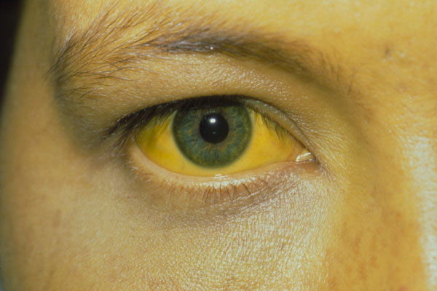
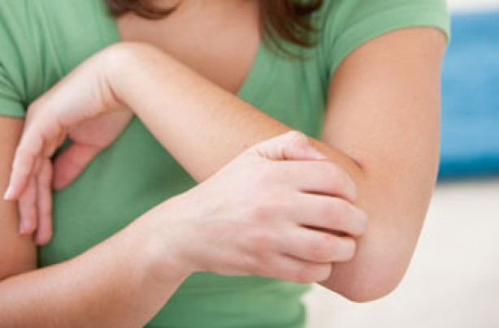
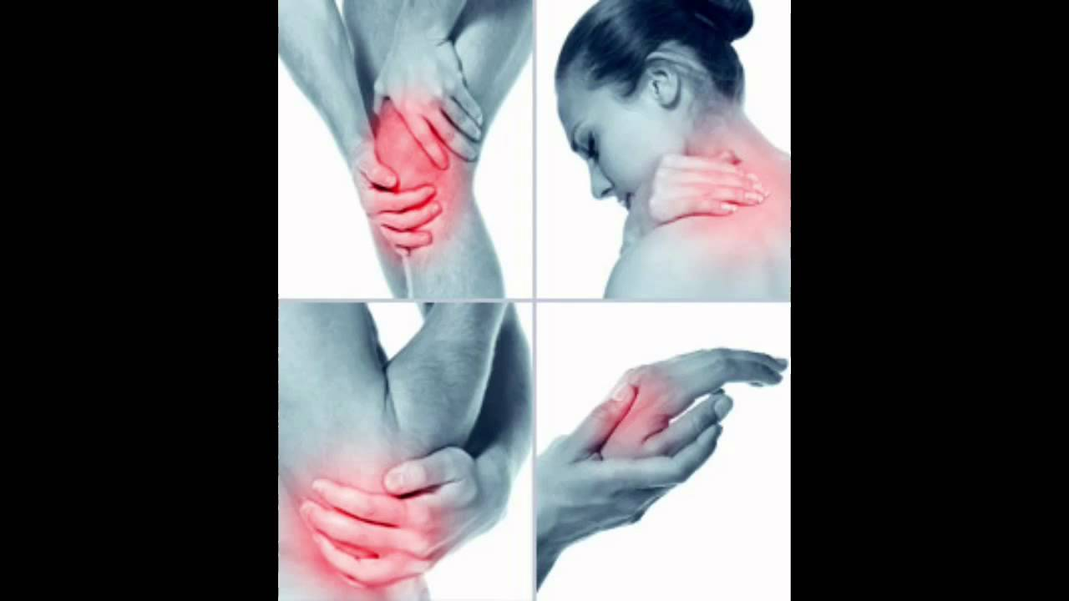
HEPATITIS C SYMPTOMS
Bleeding & Bruising easily
Fever
Dark Urine
Sore Muscles
Itchy skin

Slide 19


HEPATITIS C EXPOSURE
Primarily through parenteral exposures to human blood
Less commonly through razors, toothbrushes and unregulated tattooing
It is NOT spread through coughing, sneezing, food or water
Hep C virus can live outside the body at room temperature, on environmental surfaces, for up to 3 weeks

Slide 20
Hepatitis C Treatment
Changes rapidly and evades the immune system…making a vaccine difficult to create
New treatments that are successful in 90% of patients
There is no effective vaccine against hepatitis C so prevention depends on reducing the risk of exposure

Slide 21

HIV/AIDS
HIV- Human Immunodeficiency Virus
AIDS- Acquired Immunodeficiency Virus
HIV damages the immune system and interferes with the body’s ability to fight infection and disease
Acquired Immunodeficiency Syndrome (AIDS) is a chronic, potentially life-threatening condition caused by the Human Immunodeficiency Virus (HIV)

Slide 22
SYMPTOMS OF HIV
Within 2-4 weeks after infection, many will experience flu-like symptoms.
Fever, chills, rash, night sweats, swollen lymph nodes
These symptoms can mimic other illnesses. If you think you’ve been exposed, get checked.

Slide 23
HIV/AIDS
It is NOT transmitted by casual contact, mosquitoes or through the air
Effective treatments available
Today, someone diagnosed with HIV and treated before the disease is far advanced can live nearly as long as someone who does not have HIV

Slide 24
UNIVERSAL PRECAUTIONS (UP)
Originally recommended by the CDC in the 1980s
An approach to infection control to protect workers from HIV, HBV, and other BBP in human blood and certain other body fluids, regardless of a patients’ infection status

Slide 25

HEALTHCARE SETTINGS- STANDARD PRECAUTIONS (SP)
Although the BBP standard incorporates UP, the infection control community (Healthcare Settings) no longer uses UP on its own
Urine, feces, nasal secretions, sputum, vomit, and other body fluids may be potential sources of worker exposure to infectious agents
SP assumes that every person is potentially infected or colonized with an organism that could be transmitted in the healthcare setting
Hand hygiene; the use of certain types of PPE based on anticipated exposure; safe injection practices; and safe management of contaminated equipment and other items in the patient environment.

Slide 26
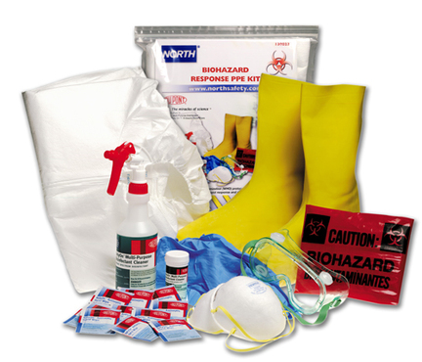
PERSONAL PROTECTIVE EQUIPMENT
Gloves
Gowns
Masks
Eye protection
Shoe covers/boots

Slide 27
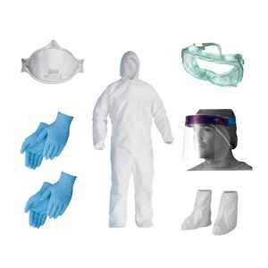
BLOOD SPILL CLEANUP
What areas on the body may be exposed?
Gloves may be the only PPE needed.
Always overreact to what you wear.

Slide 28
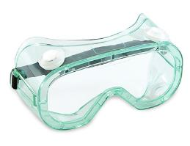
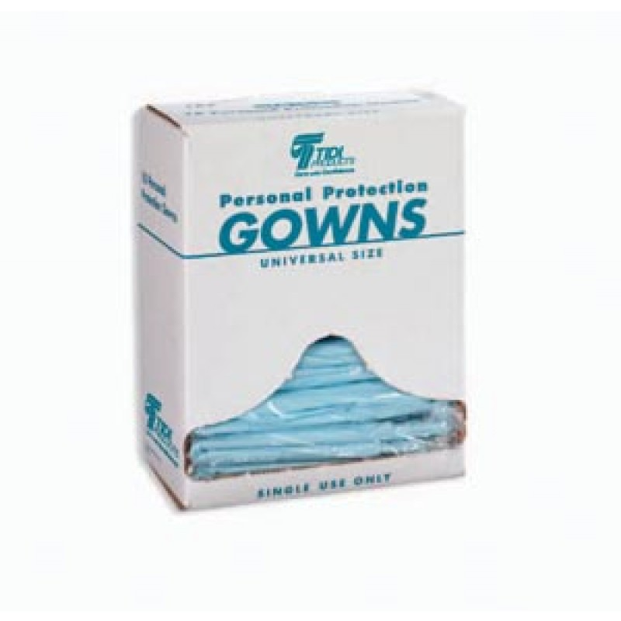
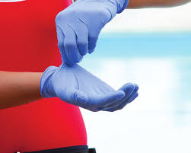
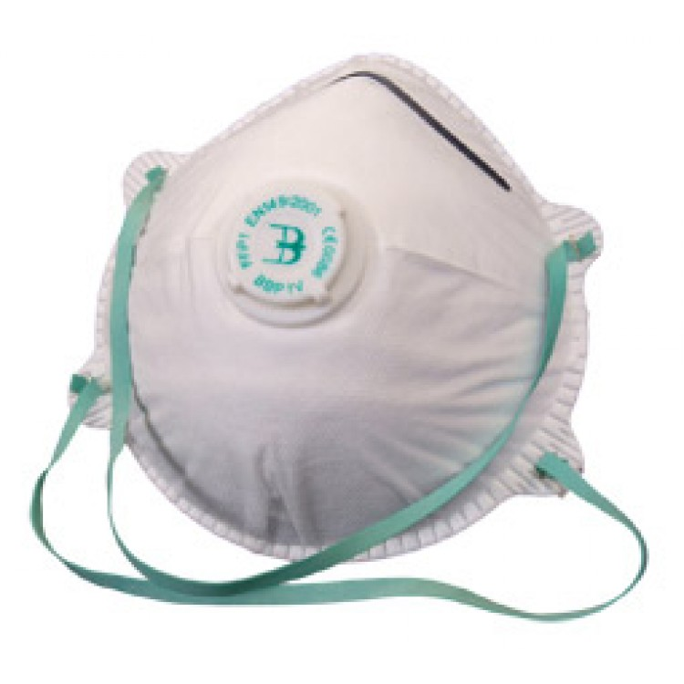
PPE REMINDERS
Check for rips, tears, defects
If PPE gets torn replace immediately
Dispose of following use

Slide 29
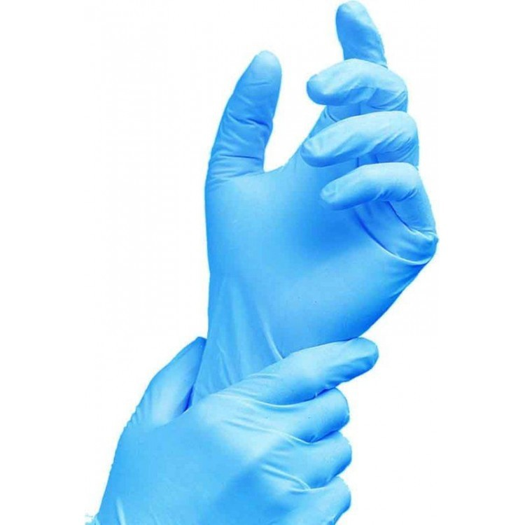
BLOOD SPILL CLEANUP
1. Isolate the area around the spill- provide a barrier to prevent access
2. Check Personal Protective Equipment (PPE) and supplies- do I have everything to do the job and protect myself
Disposable gloves- should be worn in nearly all circumstances; regardless of the spill size; bandage cuts/open wounds on hands before donning

Slide 30

BLOOD SPILL CLEANUP
3. Before starting cleanup, read the directions for the product you are using
Cleaning the spill-use paper towels, disposable wiping cloths, or solidifying agents
Allow time for spill to absorb
When using a solidifying agent,
use scoop/scraper to collect
and properly dispose of
materials (biohazard bag)

Slide 31

Environmental Protection Agency (EPA)
Surface disinfectants- rigorously tested for effectiveness
Cleaning- removing dirt/germs/impurities from surfaces
Sanitizing- kills bacteria
Disinfection- kills viruses and bacteria
Many products can do all three

Slide 32
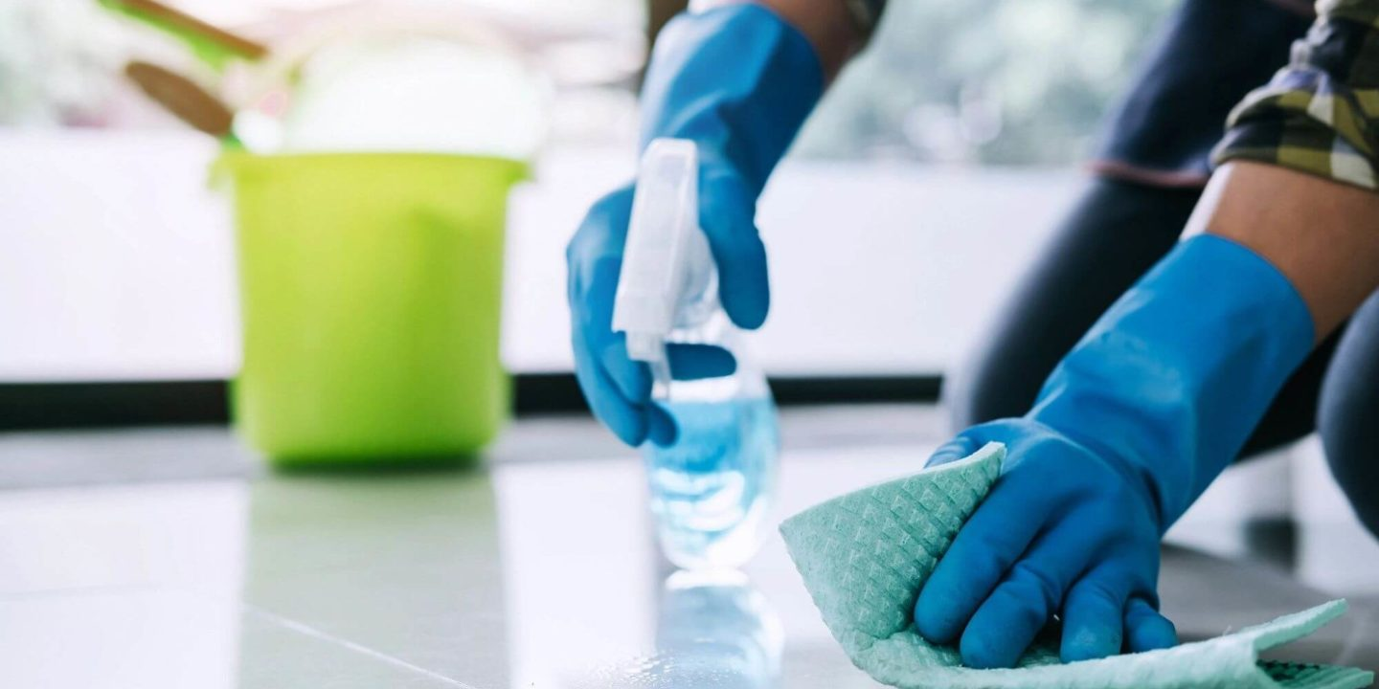
BLOOD SPILL CLEANUP
4. Disinfection of the area
Know your product(s)- are you using one product that cleans and disinfects or switching to a second product
Risk if not performed or if done incorrectly

Slide 33
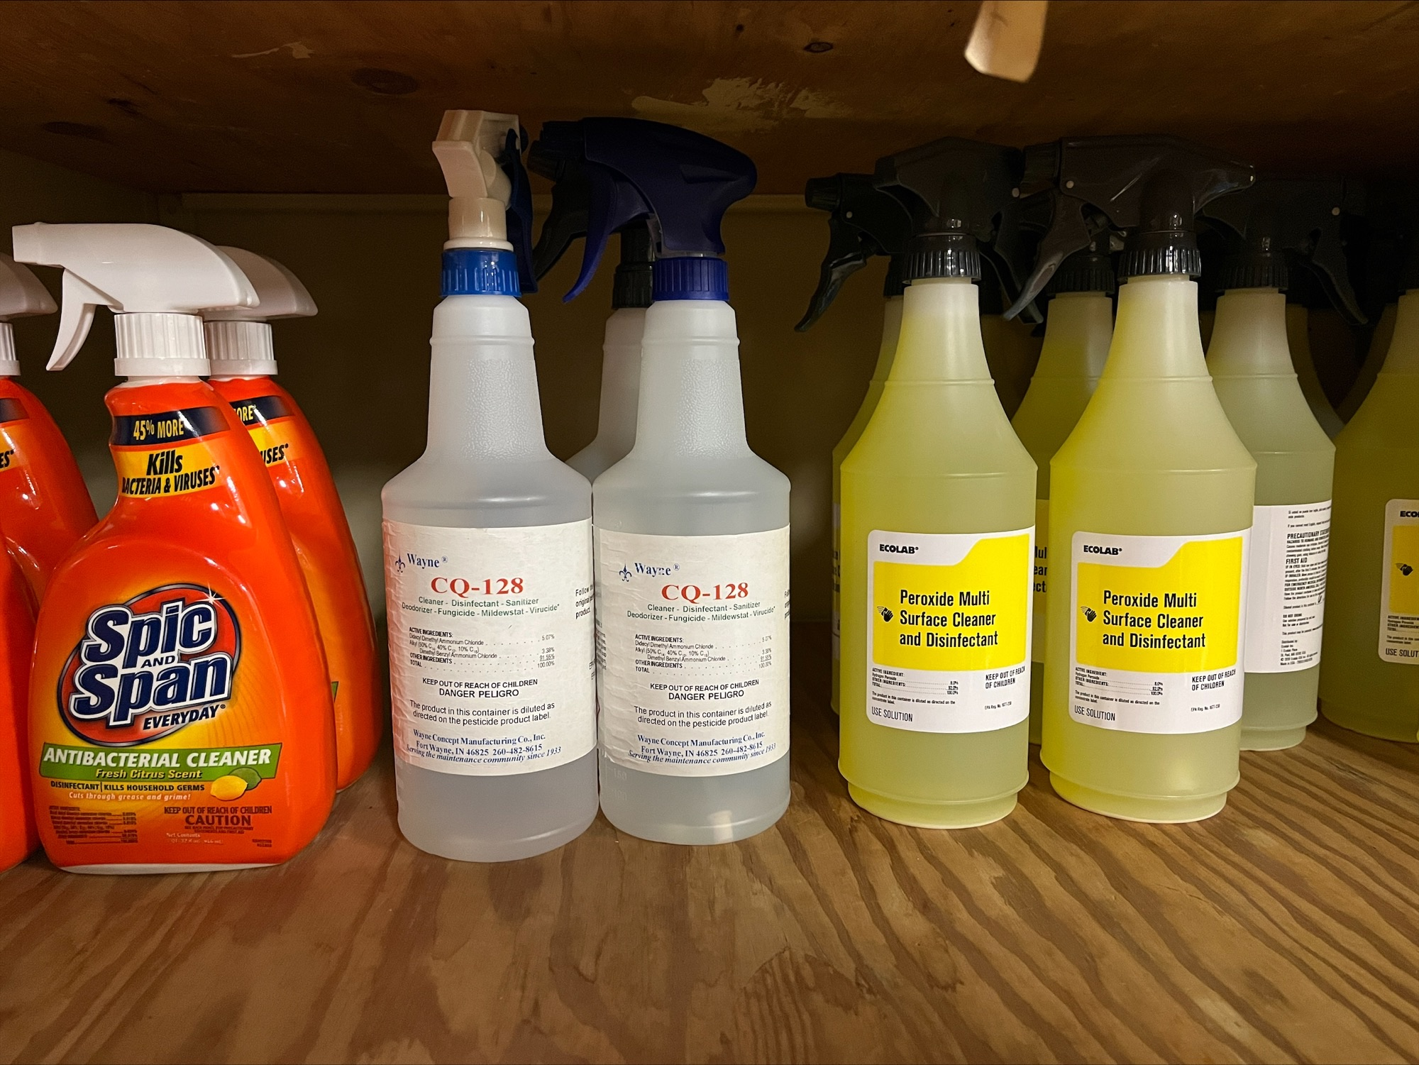
Blood Spill Cleanup
CQ-128 requires 10 minutes of surface contact time for certain viruses, including Hepatitis B, Hepatitis C, and HIV1.
Peroxide Multi-Surface requires 5 minutes of surface contact time for Hepatitis B.
Following contact time- air dry, wipe down, or rinse according to the product directions.

Slide 34
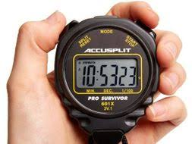

BLOOD SPILL CLEANUP
The disinfection process is critical for preventing any additional contamination.
Easy to get hurried and not give the product a chance to work.
DON’T GUESS…USE A WATCH

Slide 35
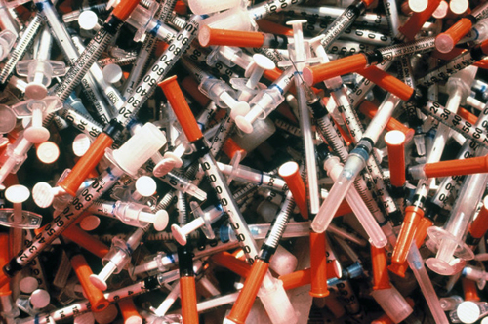
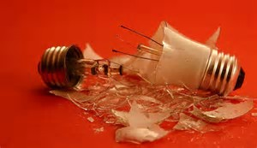
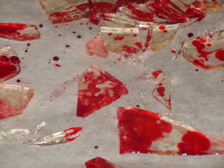

BLOOD SPILL CLEANUP
Use tongs, scoop, or scraper to collect
Never pick up with hands
Dispose in biohazard container

Slide 36
Removing PPE
1. If wearing shoe covers, remove them first
2. Gloves
-Remember, don’t touch skin, PPE, or clothing with the gloves on
3. Goggles-if wearing
4. Gown- if wearing
5. Face mask- if wearing
Wash hands with soap and water when finished.

Slide 37
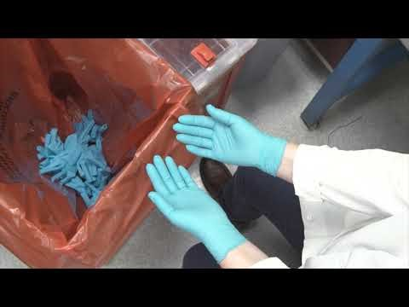
Glove Removal
Video thanks to the Cleveland Clinic Lerner Research Institute.

Slide 38
GLOVE REMOVAL
Pinch glove- Pinch the palm side of one glove near the wrist and carefully pull glove off until it’s inside out.
Slip two fingers under glove- Hold the removed glove in palm of gloved hand. Slip two fingers under the glove at the wrist of the gloved hand.
Pull glove off-The glove should come off inside out. The first glove should end up inside the glove you just removed.
Dispose of gloves and wash hands- dispose gloves & other PPE in proper biohazard container.

Slide 39
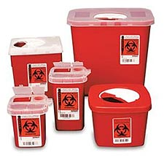
Disposal of Regulated Medical Waste
All containers or storage units must contain the Biohazard symbol OR red bags or red containers may be substituted for labels
Plastic Bags
Sharps containers
Contact me for bags/containers and for pick-up

Slide 40
Wrapping things up…
Bloodborne Pathogens can be found in blood and other potentially infectious body fluids.
An exposure incident is defined as contact with blood or other potentially infectious body fluid to the eyes, mouth, other mucous membrane, or non-intact skin. Exposures also include parenteral contact or cutting and piercing of the skin.
The Hepatitis B vaccination offers protection against the disease and is available to those employee’s in positions deemed to have potential exposure and to all employees following an exposure incident. On-the job- exposure incidents should be reported immediately to the employee's Supervisor.
Bloodborne diseases can present a variety of symptoms to those infected. To the infected person, these symptoms may be strong, felt mildly, or not at all.

Slide 41
…almost done…
Universal Precautions means we treat all human blood and certain human body fluids as if they are known to be infected with bloodborne pathogens.
Personal protective equipment should prevent blood or other potentially infectious materials from reaching work clothes, street clothes, undergarments, skin, eyes, mouth, or other mucous membranes under normal conditions of use and for the duration of time the equipment will be used.
When removing gloves or other personal protective equipment be mindful to not touch and contaminate areas outside the hazard location.
Utilize biohazard containers and bags for disposal of sharps, contaminated items, and material used during clean-up.

Slide 42

QUESTIONS?
Brandon Clidence
Ball State University
Public Health Specialist
5-2825
baclidence@bsu.edu

