Slide 1
Partnership Between Kandahar University and Ball State University
Kenneth Holland
Project Manager

Slide 2
Kandahar University Project Leadership
Chancellor, Dr. Hazrat Mir Tota Khil
Vice Chancellor, Academic Affairs, Abdul Tawab Balakarzai
Dean, Faculty of Economics, Sayeed Kabeer

Slide 3
Ball State University Project Leadership
Kenneth Holland, Dean, Rinker Center for International Programs
Garth Eberhart, Center for International Development, Project Coordinator
Michael Goldsby, Stoops Distinguished Professor of Entrepreneurship
Mary Theresa Seig, Director, Intensive English Institute
Mollie Fout, Director, Career Center
Ajmal Burhanzoi, Graduate Assistant

Slide 4
Funding
U. S. Department of State, U. S. Embassy Kabul, Public Affairs Section/English Language

Slide 5
Purposes of the Partnership
Enhance English language proficiency of teachers and students in Faculty of Economics
Develop a curriculum in entrepreneurship for Faculty of Economics
Develop a Career Center

Slide 6
English Language Training
Faculty members and students will receive intensive English training at the University of Malaya in Kuala Lumpur, Malaysia
BSU will assist faculty members in teaching their courses in English
BSU will assist faculty members in conducting research and writing scholarly papers in English

Slide 7
Entrepreneurship
Professor Michael Goldsby, Director of BSU’s internationally recognized Center for Entrepreneurship, will conduct workshops for faculty members in how to teach entrepreneurship.
Entrepreneurship is best taught using a combination of lecture, hands-on practice and visits to successful small- and medium-sized businesses.

Slide 8
Entrepreneurship Can Fuel Economic Growth in Afghanistan
An entrepreneur is someone who transforms innovations into economic goods by starting new businesses
Entrepreneurs have many of the same character traits as leaders
Both economic theory and experience show that entrepreneurs contribute significantly to economic growth because of their propensity to innovate

Slide 9
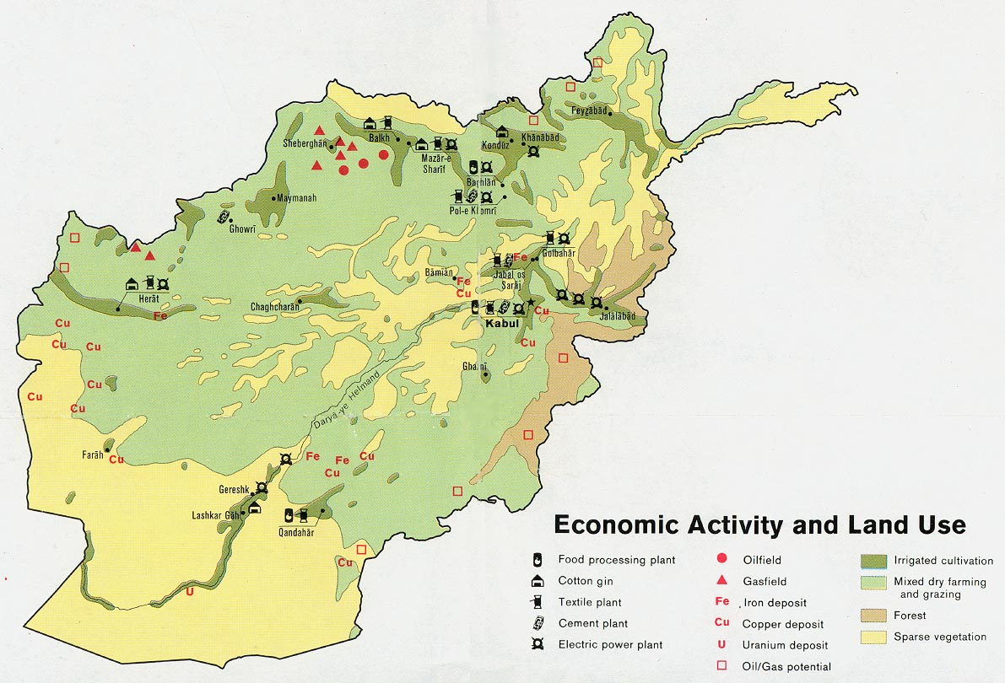

Slide 10
Arghandab and Helmand River Valleys as Engines of Economic Growth
The wealth-generating potential of these river valleys in southern Afghanistan is very high
Canada is spending $50 million on repairs to the Dahla Dam on the Arghandab River to promote economic growth
There are growing opportunities for entrepreneurs in agribusiness, construction, engineering, mining and other areas, including export of value-added agricultural products

Slide 11
Career Center
BSU is assisting Kandahar University establish a Career Center
The Career Center will be a link between public and private employers and the students

Slide 12
Kandahar University Career Center
Services and activities include
  Organizing on-campus job fairs
  Managing a student internship program
  Training in “soft skills” that students need to find good jobs
    Interview skills
    Etiquette and dress
    Doing business with foreigners
  Tracking graduates
  Eliciting employer feedback on quality of graduates

Slide 13
Career Center Staff
Career Center Staff are included in the tashkil for Kandahar University
The staff will receive training at the University of Malaya
Space for the Career Center has been allocated in the planned University auditorium
The BSU project will equip the Career Center with computers linked to the internet

Slide 14
Conclusion
The Faculty of Economics at Kandahar University is in its first year
It currently has 14 faculty members and 92 students
It will grow rapidly over the next few years
It has the potential of educating large numbers of young people who will make a significant contribution to the economic growth and wealth of the four southern provinces and, thereby, benefit millions of Afghans

