Slide 1

INSURANCE OPEN ENROLLMENT FOR CALENDAR YEAR 2027
October 27, 2026 – November 12, 2026
Employee Benefits
Open Enrollment 2027

Slide 2
Insurance OE Checklist For Retirees
  If you are enrolled in the Under 65 Retiree PPO Health Plan, you must complete a new Tobacco-Free Affidavit by November 13, 2026, to begin or continue your tobacco-free premium discount for 2027.
  Under 65 Retiree Monthly Rates for 2027 - Tobacco Free (TF) / Tobacco (T):
  Medical Dental
  TF / T
      Single $188.17 / $263.17 $13.31
      EE/Child(ren) $371.77 / $446.77 $25.26
      Family $492.49 / $567.49 $34.47
  Over 65 Medicare Supplement Plan rate remains at $133.73 per month per person, dental insurance remains at $13.31 per month.
  Billing for heath, dental and life insurance will continue to be processed and mailed on a monthly basis.
Employee Benefits
Open Enrollment 2027

Slide 3
2027 Insurance Open Enrollment
Please review your 2027 insurance benefits. Re-enrollment is required each year to continue some benefits into the following plan year, including:
Flexible Spending Accounts (FSA)
Health Savings Account (HSA) Contributions
Tobacco-Free Premium Discount Affidavit: If you do not take any action during Open Enrollment you will lose your tobacco-free premium discount beginning January 1, 2027.
Employee Benefits
Open Enrollment 2027

Slide 4
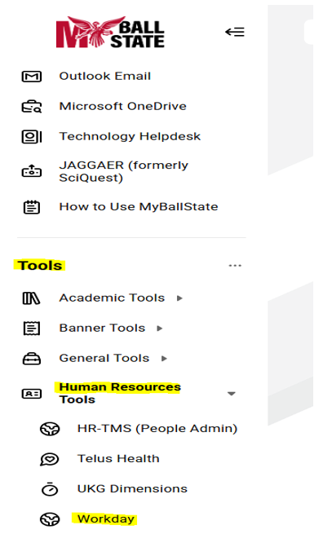
Access Open Enrollment in Workday
Sign in to the MyBallState Dashboard to access Workday. Workday access is located on the left side of the dashboard. Scroll down the left side of the page to Tools and then click on the arrow to the right of Human Resource Tools and scroll down to Workday and click on it and it will take you to Workday. There will be an Open Enrollment task awaiting action in your task box to select to start reviewing your 2027 benefits. Review all details including the dependents covered and covered amounts for all plans.
If making changes, please ensure you have all of your family’s information readily available. (Ex. Child’s birth certificate, marriage license and social security numbers.)
If your spouse had a change in employment or coverage eligibility status, please upload an updated Working Spouse Affidavit.
We will be conducting a dependent plan audit in 2027, look for more information in the spring of 2027
Employee Benefits
Open Enrollment 2027

Slide 5
2027 Active Employee Premiums
Health Plan Premiums (Medical & Prescription) TF = Tobacco Free | High Deductible Health Plan |  | PPO Health Plan
 | Biweekly |  | Biweekly
 | 10 Month (18 Pays) | 12 Month (26 pays) | 10 Month (18 Pays) | 12 Month (26 pays)
SingleTF | $84.75 | $58.68 | $125.45 | $86.85
Single Full | $134.75 | $93.29 | $175.45 | $121.46
EE+CH TF | $170.51 | $118.04 | $247.85 | $171.59
EE+CH Full | $220.51 | $152.66 | $297.85 | $206.20
Family TF | $222.68 | $154.16 | $328.33 | $227.30
Family Full | $272.68 | $188.78 | $378.33 | $261.92
Active Employee Dental Plan Rates | Biweekly
 | 10 Month (18 pays) | 12 Month (26 pays)
Single | $8.87 | $6.14
EE+CH (Employee +Child(ren) | $16.84 | $11.66
Family | $22.98 | $15.91
Employee Benefits
Open Enrollment 2027

Slide 6
Making Your Medical Plan Decision
There are 2 active employee medical plans to choose from:
The HSA Qualified Health Plan
  Lowest premiums
  Paired with a tax-advantage HSA account
  Once the deductible is satisfied, medical expenses are paid at 80% by the University (and non-preventive prescriptions are paid at their appropriate Coinsurance)
  Once the out-of-pocket maximum is satisfied, medical and prescription expenses are paid at 100% by the University
The PPO Health Plan
  Highest Premiums
  Once the medical deductible is satisfied, medical expenses are paid at 80% by the University
  Medical & prescription expenses now accumulate toward the same out-of-pocket maximums and once satisfied, expenses are paid at 100% by the University
  Prescription copays immediately
Employee Benefits
Open Enrollment 2027

Slide 7
PPO Health Plan
  Deductible: $2,000 individual / $4,000 employee/child or family
  Out-of-Pocket (OOP) Maximum:
      In-Network providers: $5,050 per person / $10,750 family
      Prescription: Now Included in Medical out-of-pocket
      80% coinsurance for in-network providers
Employee Benefits
Open Enrollment 2027
Notes:
Going into further detail for the PPO Health Plan….There are changes to the deductibles and OOPMs this year for this plan.
Your Deductible remains is $2000 for individual and $4000 for employee/child or family coverage. Prescription costs are now included in medical out of pocket, this is a change from last year.

Slide 8
PPO Health Plan
How the PPO Health Plans works:
The family deductible must be met by a combination of family members.
No one member can meet more than the plan’s single deductible amount.
Each member has their own out-of-pocket maximum for medical.
Lab charges at LabCorp, Quest Diagnostic, and American Health Network are covered at 100%. The labs at American Health Network must be billed by LabCorp or American Health Network to be covered at 100%.
This Plan can be paired with a General Purpose FSA (Flexible Spending Account) to pay for your out-of-pocket expenses using pre-tax dollars.
Employee Benefits
Open Enrollment 2027

Slide 9
HSA Qualified Health Plan
Deductible: $3,000 individual / $6,000 employee/child or family
Out-of-Pocket (OOP) Maximum:
  In-Network providers:
    Currently $5,250 individual (employee only plan)
    Currently $7,600 individual/$9,000 family (employee/child or family plan)
    OOP maximums include the deductible
  Medical/Prescription are combined for deductible/OOP
  80% coinsurance for in-network providers
Employee Benefits
Open Enrollment 2027
Notes:
Now on to more detail about the HSA Qualified Health Plan….There are changes to the deductibles and OOPMs this year for this plan.
Your deductible will be $3000 for single and $6000 for employee/child or family coverage
On the next slide we will go into more detail about the deductibles and OOPMs

Slide 10
HSA Qualified Health Plan
How the HSA Qualified Health Plan works:
If you have employee/child or family coverage, the entire $6000 family deductible must be met before benefits are paid.
The deductible and out-of-pocket can be met by one family member up to a maximum of $7,600. The remainder of the out-of-pocket must be met by other family members.
Medical and prescription expenses are combined to meet the deductible and out-of-pocket.
All medical and prescription expenses, with the exception of preventive services and medications, are subject to the deductible.
Lab charges at the contracted labs are paid at 100% after the deductible is met.
This Plan can be paired with an HSA (Health Savings Account) to pay out-of-pocket expenses with pre-tax dollars
Employee Benefits
Open Enrollment 2027

Slide 11
Health Savings Account (HSA)
What’s an HSA?
The HSA is an IRS-regulated savings account for saving tax-free dollars to pay for IRS-qualified medical expenses
You must be enrolled in the HSA Qualified Health Plan to open and contribute to an HSA
You cannot be covered by any other type of non-qualified health plan, including Medicare, Tri-Care, or a spouse’s FSA
You can only use an HSA tax-free for expenses incurred after your HSA is opened
When opening your HSA make sure you assign a beneficiary to your account. Beneficiary designations can be completed on your Fidelity account, www.nb.fidelity.com or call the Client Assistance Center at 800-544-3716.
The funds in your HSA are yours to keep; there is no “use it or lose it” even if you change jobs or health care plans
Funds may be used for the medical expenses of your spouse or any of your IRS dependents, even if these individuals are not covered by the HDHP
If you use your HSA to pay for non-QMEs, the amount is included in your income (taxed) and is subject to a 20% penalty
At age 65, you can use this account to pay for anything you want without penalty, but non-medical expenses will be considered taxable income
Employee Benefits
Open Enrollment 2027
Notes:
What is an HSA?
An HSA is an IRS regulated savings account, to allow you to save tax free dollars to pay for you, your spouse and any of your IRS tax dependent’s current and future years qualified medical expenses. You need to be enrolled in the HSA Qualified Health Plan to contribute and cannot be covered by any other non-qualified HSA plan. This includes Medicare, Medicaid, tri-care or a spouse’s FSA. You can only use an HSA tax-free for expenses incurred on or after the date your HSA is opened. Make sure that when you are setting up your HSA you assign a beneficiary to your account. This designation can be changed at any time during the life of your HSA. The beneficiary form can be found on the Fidelity account online using www.nb.fidelity.com or call the Client Assistance Center at 800-544-3716.
The biggest difference between an HSA and an FSA is with an HSA there is no ‘use it or lose it’ clause. Also, an HSA is truly owned by you, the employee and not Ball State. So if you switch health plans or leave the university, you keep the funds that have been accumulated in your account.
If you use this account to pay for anything that is a not a qualified medical expense and you are audited by the IRS, it will be included in your taxable income and be subject to a 20% tax penalty. The IRS can go back 7 years to ask for substantiating documentation so make sure you keep your receipts and explanation of benefits. However once you turn age 65, you can use this account to pay for anything you want with no penalty, but it would be included in your taxable income.

Slide 12
Health Savings Account (HSA)
What does an HSA pay for?
  The tax-free dollars you save in an HSA can only be used to pay for “IRS-qualified medical expenses” including:
    You can find a list of IRS-qualified medical expenses on the IRS website (www.IRS.gov). If you have questions about the eligibility of a medical expense, please consult your tax advisor or the IRS
    Ball State now uses Fidelity for making employer contributions and pays the monthly maintenance fee for the account on your behalf
  Medical expenses before and after you meet your health plan’s deductible
  Dental and Vision care services
  Prescriptions
  Over-the-counter medications IF prescribed by your doctor
  Certain medical equipment
  COBRA premiums for continuing coverage
  Coverage over age 65, including Medicare or employer retirement health premiums
Employee Benefits
Open Enrollment 2027
Notes:
What does and HSA pay for?
Anything subject to your medical plan, dental and vision expenses, prescriptions. You can even use this account to pay COBRA premiums if you ever need to elect COBRA.
The IRS publishes a list of qualified medical expenses on their website at www.IRS.gov -- it is Publication 502.
Ball State now uses Fidelity for making employer and employee pre-tax contributions. While you are an active employee, we will pay your monthly maintenance fee on your behalf to Fidelity.

Slide 13
Health Savings Account (HSA)
2027 HSA Contribution Limits
  Single/Individual: $4,500
  Employee Plus Child(ren)/Family: $9,000
  Age 55+: Additional $1,000 ‘catch up’ contribution
The University’s contribution is deposited on a per pay basis (at the same time as your own contribution).
2027 HSA Seed Amounts | 10 Month University Seed |  | 10 Month Employee Required 25% Match |  | 12 Month University Seed |  | 12 Month Employee Required 25% Match
 | Biweekly | Annual | Biweekly | Annual | Biweekly | Annual | Biweekly | Annual
Single | $29.38 | $528.84 | $7.35 | $132.30 | $20.34 | $528.84 | $5.09 | $132.34
EE+CH/Family | $73.45 | $1,322.10 | $18.36 | $330.48 | $50.85 | $1,322.10 | $12.71 | $330.46
2027 Totals | Single Contribution |  |  |  | EE+CH/Family Contribution
 | (University + Employee) |  |  |  | (University + Employee)
 | $661.14 |  |  |  | $1,652.56
Employee Benefits
Open Enrollment 2027

Slide 14
Flexible Spending Accounts (FSA)
This account lets you use pre-tax dollars to pay for eligible health care expenses for you, your spouse and your eligible dependents
Dependent Care FSA | Health Care FSA (General Purpose) | Limited Purpose Health FSA (for employees also contributing to an HSA)
For your adult or child day care expenses | For you and your dependents’ eligible out-of-pocket expenses | For you and your dependents’ eligible out-of-pocket dental and vision expenses
Contribute up to $7,500 (pre-tax) | Contribute up to $3,400 (pre-tax) | Contribute up to $3,400 (pre-tax)
Election amount is available on a reimbursement basis only. $7,500 maximum contribution per household per year | If you and your spouse both work and the plan is offered by both employers, you can each contribute $3,400 in 2027 | If you and your spouse both work and the plan is offered by both employers, you can each contribute $3,400 in 2027.
ESTIMATE YOUR CALENDAR YEAR ELECTION CAREFULLY! THESE ACCOUNTS ARE “USE IT OR LOSE IT”
FLEX PLAN YEAR FOR BALL STATE IS JANUARY 1, 2027 – MARCH 15, 2028
Employee Benefits
Open Enrollment 2027

Slide 15
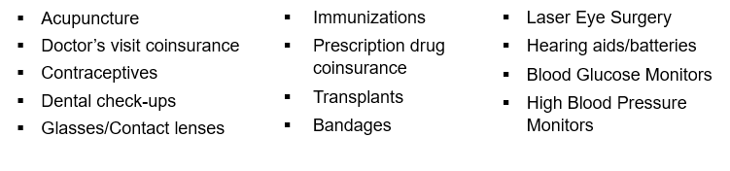
Flexible Spending Accounts (FSA)
Eligible General Purpose Expenses Include:
General Purpose FSA Expenses NOT COVERED Include:
Cosmetic Surgery
Vitamins
Teeth Whitening
Insurance Premiums
Employee Benefits
Open Enrollment 2027
Notes:
Here are a few examples of what you can use a general purpose FSA on.
Anything subject to your health plan, prescription, dental and vision expenses and even laser eye surgery that you are responsible to pay for.
Some things that you can not use a general purpose FSA on… cosmetic surgery, vitamins, teeth whitening and insurance premiums.

Slide 16
PRESCRIPTION PLAN CHANGES
PPO PLAN HDHP PLANS
Prescription Drug (Retail)
Rx Deductible (Per Person/Family) Integrated with Medical Integrated with Medical
RX Out–of-Pocket Maximum (Per Person/Family) Integrated with Medical Integrated with Medical
Tier 1 (Generics) 20% ($15 min/$40 max) 20% ($15 min/$40 max)
Tier 2 (Preferred Brand) 40% ($65 min) 40% ($65 min)
Tier 3 (Non-Preferred Brand) 50% ($100 min) 50% ($100 min)
Tier 4 (Specialty) $250 $250
PPO PLAN HDHP PLANS
Prescription Drug (Mail)
Rx Deductible (Per Person/Family) Integrated with Medical Integrated with Medical
RX Out–of-Pocket Maximum (Per Person/Family) Integrated with Medical Integrated with Medical
Tier 1 (Generics) 20% ($30 min/$80 max) 20% ($30 min/$80 max)
Tier 2 (Preferred Brand) 40% ($130 min/$180 max) 40% ($130 min/$180 max)
Tier 3 (Non-Preferred Brand) 50% ($200 min/$250 max) 50% ($200 min/$250 max)
Tier 4 (Specialty) $250 $250
Employee Benefits
Open Enrollment 2027

Slide 17
Specialty Pharmacy Changes
Specialty medications are a huge cost driver to our plans. Effective January 1, 2027, our specialty pharmacy administration will change from CVS Pharmacy to Archimedes, LLC, which should result in providing high level support to members utilizing specialty medications while also attempting to control the cost of these medications.
Communications will be sent to individuals who currently have specialty prescriptions informing them how this transition will occur.
The new specialty prescription copay effective January 1, 2027, will be $250.
Employee Benefits
Open Enrollment 2027

Slide 18

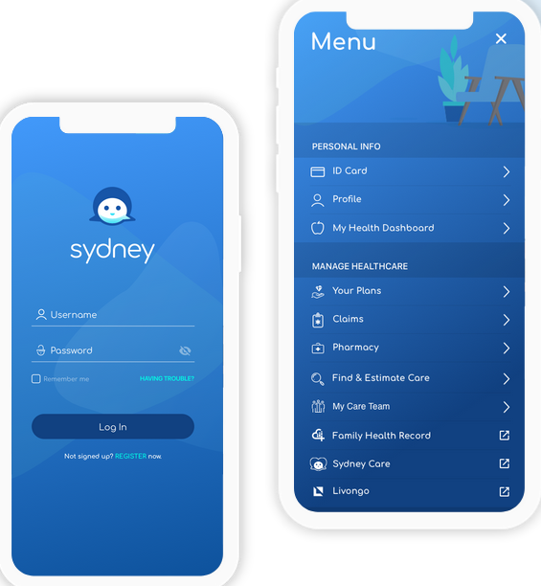

Sydney Health
Sydney connects you to everything you need to know about your health plan — all in one place. We encourage insurance plan members to utilize Sydney Health to make informed decisions about your health care options, with quality of care and cost of services available to you. You can:
Find care and check costs: It’s easy to search for doctors, hospitals, labs and other providers in your plan. You can search by name, location and type of care then check costs before you go. This helps you find what’s best for you.
View claims: Check medical claims in one click. That means you can spend more time focused on your health and less on managing your health benefits.
View and use digital ID cards: You can always have your most current ID card handy and you can use it just like a paper one when you visit the doctor to pay for care and more.
See all benefits: Sydney shows you essential information at a glance, whether that’s an overview of your plan, health reminders or suggestions for wellness programs. You also can find your deductible, copay and share of costs.
Sydney Health app is available for both iPhone and Android and it is free!
Employee Benefits
Open Enrollment 2027
Notes:
The Sydney Health platform is available to all active employees enrolled in an Anthem health plan.
Features of the Sydney Health app included:
Finding care and checking costs: We encourage all employees to use this tool to find the best quality care. Search for doctors, hospitals, etc., in our network and compare costs. We also encourage employees to be good stewards of your health care spend and ensure that you are getting the best quality of care and cost when having procedures done in order to keep claims and premiums low.
You can easily view your claims, View and use digital ID cards, See all of your available benefit details such as your deductible, any copays or share of costs.
Sydney Health app is free and available for both the iPhone and Androids. You can find it on the app store or google play.

Slide 19
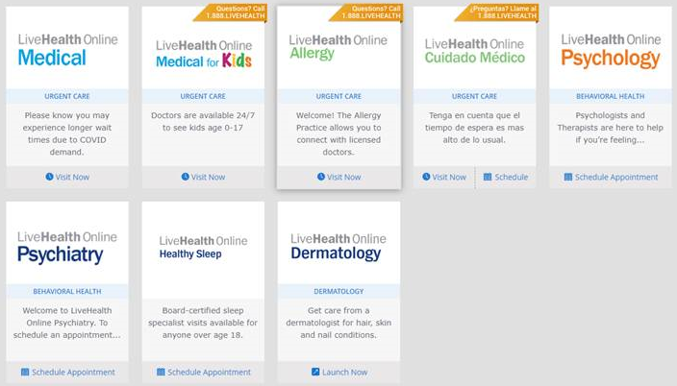
LiveHealth Online
LiveHealth Online Medical
  See a board-certified doctor in minutes using your smartphone, tablet or computer with a webcam.
    The doctors using LiveHealth Online will typically charge less than an in-person visit, depending on your health plan.
  Sign up for free to get:
    24/7 access to doctors –get care when your primary doctor isn't available!
    Medical care when you need it – treat the flu, cold, sinus infection, pink eye, rashes, fever and more
    Convenient – no appointments or long lines! Connect with a doctor in 10 minutes or less!
LiveHealth Online Psychology
  Easy, convenient way to see a therapist or psychologist in just a few days
  Cost is similar to an office therapy visit, subject to deductible and coinsurance
Employee Benefits
Open Enrollment 2027
Notes:
Ball state continues to utilized Live Health Online for our health plan members.
LiveHealth Online Medical………read slide

Slide 20

Dental
Deductible:
    Individual - $60 per person per calendar year
    Family - $150 per family per calendar year
Preventative Services are paid at 100%, not subject to deductible
Major Services (including Orthodontia for age 19 and under) are paid at 70% after deductible
$1,500 per calendar year maximum benefit
$500 per calendar year Orthodontia maximum benefit (for age 19 and under), separate from
dental maximum
Delta Dental PPO Providers are paid at 85% for Basic Services
Visit deltadentalin.com/bsu to access plan information, print ID cards, find a dentist, and view your Explanation of Benefits
Employee Benefits
Open Enrollment 2027

Slide 21
Voluntary Benefits
Voya - Voluntary Life and STD Insurance
  Voluntary Life Insurance
                Maximum coverage: Employee = $500K, Spouse = $250K, Children = $10K
            Guarantee issue: Employee = $200K and Spouse = $50K
            If you are currently enrolled you may increase your amount by 1 increment; if you are not currently enrolled you will need to complete the Evidence of Insurability application with Voya for approval
  Voluntary STD Insurance
    Available to non-service employees only
    The weekly benefit amount will be 60% of your weekly wages not to exceed $1,500.
VSP - Voluntary Vision Insurance
  Two plans, Basic & Premier
Employee Benefits
Open Enrollment 2027

Slide 22
Mandatory Benefits
Premiums for Life, AD&D and LTD will continue to be paid 100% by the University
ASO STD is 75% subsidized by the University—These plans are administered by Voya
Life Insurance
    Approximately 2 times base salary with a $125,000 maximum benefit
Accidental Death & Dismemberment (AD&D)
    Benefits payable for accidental loss of limb or sight; benefit doubles for accidental death to a maximum benefit of $125,000
Long Term Disability (LTD)
    Provides income replacement of 60% of calculated pay (subject to taxes) after a specified waiting period
University Subsidized Short Term Disability (ASO STD)
    Provides income replacement of 80% of calculated pay (subject to taxes) after a 7-day waiting period
    For service employees only
Employee Benefits
Open Enrollment 2027

Slide 23
OE Checklist for Active Employees
Review your 2027 Benefits Open Enrollment Information Guide
Attend our Cardinal Day of Well-Being and Benefits Fair on November 5, 2026
If you do not know your BSU username and password, contact the BSU Help Desk at 5-1517
Complete your 2027 benefit enrollment in Workday by Thursday, November 12, 2026
Have questions or need assistance? Attend one of our OE sessions or contact the Employee Solution Center at 285-1834 to speak with a Benefits Specialist
Employee Benefits
Open Enrollment 2027

Slide 24
Office of Employee Benefits
Angie Gregory
Director of Benefits
285-2353
akgregory@bsu.edu
Senior Benefit Specialist – Active & Retirees
Penny Masters
285-8496
pmmasters@bsu.edu
Benefits Specialist – Active Employees
Scott Turner
285-8469
tsturner@bsu.edu
Benefit Specialist – Active Employees
Elizabeth Batt
285-8404
Elizabeth.batt@bsu.edu
Benefit Specialist - Retirees
Lauren Craycraft
285-8470
Lauren.craycraft@bsu.edu
Employee Benefits
Open Enrollment 2027

